Slide 1
Safety Guidelines Illness and Injury Prevention
2.01 Understand safety procedures

Slide 2
Safety Guidelines Illness and Injury Prevention
Requires employers to:
Have an Illness and Injury Prevention Plan
Provide training regarding the plan
Provide safety equipment for the employee
2.01 Understand safety procedures

Slide 3
Safety Guidelines Illness and Injury Prevention
Requires employees to:
Use products as directed
Understand potential hazards
Store products and equipment properly
Right to immunizations if high-risk for exposure within the first 10 days of work
2.01 Understand safety procedures

Slide 4
Safety Guidelines Regulatory Agencies Review
The Regulatory Agencies are presented here as a review from 1.03 Understand healthcare agencies, finance and trends.
2.01 Understand safety procedures

Slide 5
Safety Guidelines Regulatory Agencies Review
Centers for Disease Control and Prevention (CDC)
Concerned with causes, spread, and control of diseases in population
Focus Areas:
Adverse Events
Hand Hygiene/Standard Precautions/Infection Control
Injection Practices
2.01 Understand safety procedures

Slide 6
Safety Guidelines Regulatory Agencies Review
Occupational Safety and Health
Administration (OSHA)
Creates and enforces standards that apply specifically to healthcare facilities
Main Focus Areas for Healthcare
Occupational Exposure to Hazardous Chemicals Standards
Bloodborne Pathogen Standard
Conducts workplace inspections
2.01 Understand safety procedures

Slide 7
Safety Guidelines Regulatory Agencies Review
International and National Joint Commission on Safety
Promotes specific improvements in patient safety
Highlight problematic areas in healthcare
Requirements focus on system wide solutions
Standards are evaluated and updated annually as necessary
2.01 Understand safety procedures

Slide 8
Safety Guidelines Regulatory Agencies Review
Environmental Protection Agency (EPA)
Goal is to protect human health and environment.
Enforces specific regulations in healthcare, including proper disposal of biohazardous waste.
2.01 Understand safety procedures

Slide 9
Safety Guidelines Regulatory Agencies Review
Food and Drug Administration (FDA)
Responsible for protecting and advancing public health.
Regulates food and drug products sold to the public.
2.01 Understand safety procedures

Slide 10
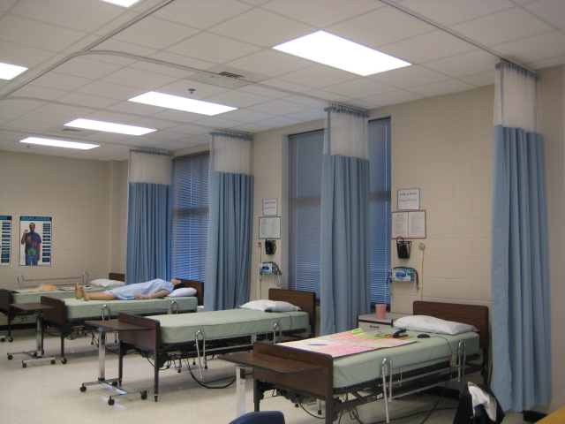
2.01 Understand
safety procedures
2.01 Understand safety procedures

