Slide 1
3.06 Understand the functions and disorders of the integumentary system

Slide 2
Essential Questions:
What are the functions of the integumentary system?
What are some disorders of the integumentary system?
How are integumentary system disorders treated?
How do you relate the integumentary system to the body’s communication systems?

Slide 3
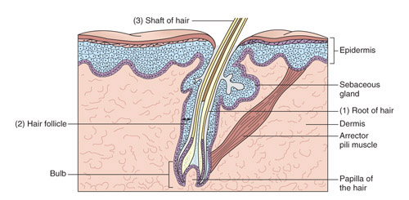
Functions of the integumentary system
What are the functions of the skin?
What structures are involved in these functions?
1
3
5
7
4
2
6

Slide 4
Functions of the integumentary system
1
Protection
Absorption
Excretion
Production of Vit. D
Body Temp Regulation
Sensory Perception
Storage
2
3
4
5
6
7

Slide 5
Functions of the integumentary system
Epidermis
  Keratin provides a waterproof covering that resists excess water loss
  Barrier against UV Light (melanocytes), bacteria, abrasions, chemicals
  What is a major function of intact skin?
    Protection

Slide 6

Functions of the integumentary system
Epidermis
  Why are some people dark and others fair?
  Can that be changed?

Slide 7
Functions of the integumentary system
Dermis
  Contains pressure and pain receptors
  Blood vessels here help maintain homeostasis
  Oil production-keeps skin smooth, soft, waterproof
  Growing hair

Slide 8
Functions of the integumentary system
Subcutaneous layer
  Hypodermal layer
  Hypo- dermal
  Stored adipose-prevents heat loss
  Attaches to muscle tissue (connecting skin to bones/muscle)

Slide 9
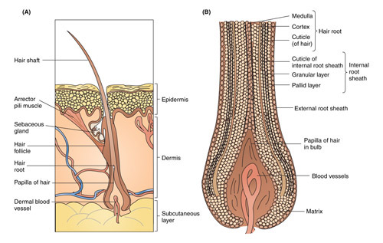
Functions of the integumentary system
Hair
  Protection-How?
  Sensory
  What factors influence hair type and color?
    Color: Cortex
    Type: Shape of follicle
      Round = Straight
      Oval = Wavy
      Flat = Curly
  What happens to your hair when you are cold? Why?

Slide 10
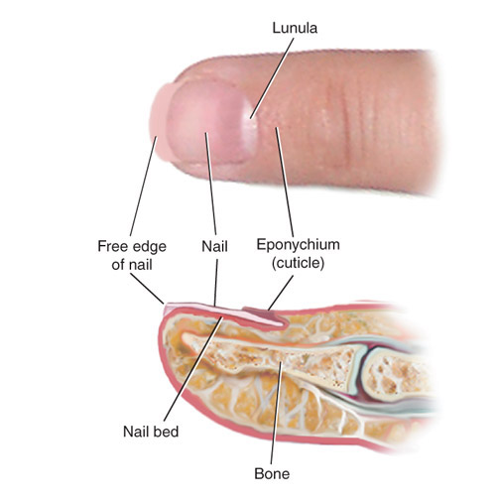
Functions of the integumentary system
Nails
  Protection of the distal phalanx
  What does the condition of a person’s nails tell about their general health?
    Color – Deficiencies/loss of nutrients
    Texture – Physical and mental conditions indicated
      Flaky: overconsumption of sugar
      Horizontal ridges: indicate high levels of stress

Slide 11
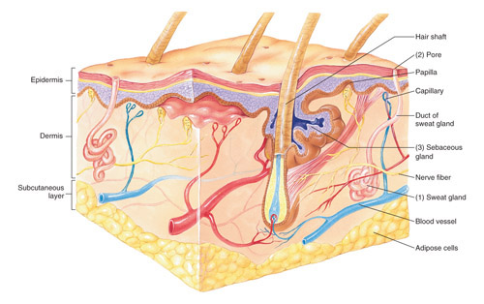
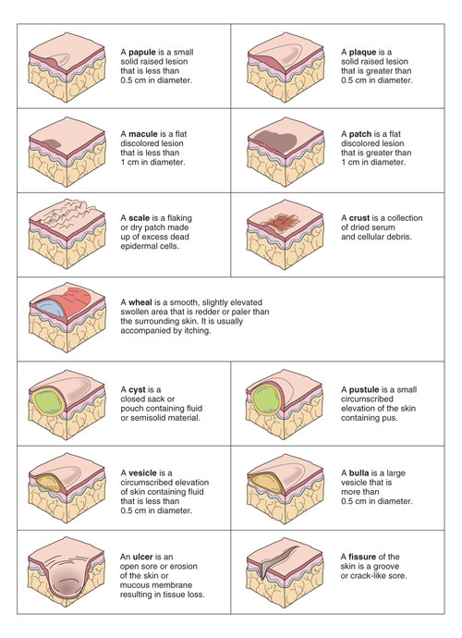
Functions of the integumentary system
Glands
  Sudoriferous glands
  Why does sweat smell bad?
  Sebaceous glands
    What role do sebaceous glands have in relation to pimples?
Pimple

Slide 12
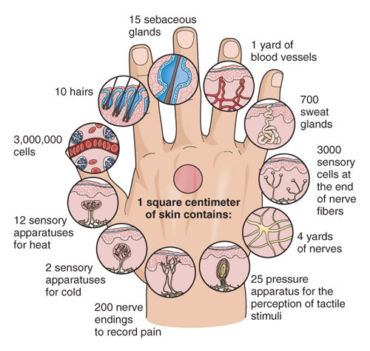
Functions of the integumentary system
review
What are the functions of the skin?
What structures are involved in these functions?
1
3
5
7
4
2
6

Slide 13
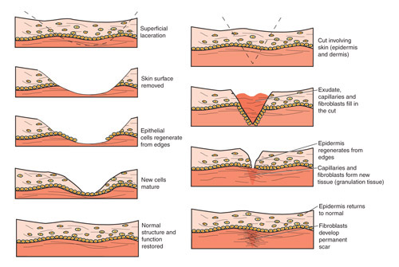
Functions of the integumentary system
The skin has remarkable ability to heal itself.
How does this happen?

Slide 14
Disorders of the integumentary system
Acne vulgaris:
What is acne vulgaris?
  Disorder of sebaceous gland; overproduction of oil leading to clogged hair follicles
  s/s: white heads, black heads, painful lumps beneath the skin, small, red, tender bumps

Slide 15
Disorders of the integumentary system
Acne vulgaris:
How is it treated?
  OTC Treatments, Topical Medications, Oral Medications, Light Therapy, Chemical Peel, Dermabrasion
Can it be prevented?
  Wash face daily, use oil free make up removers, shower after strenuous activity

Slide 16
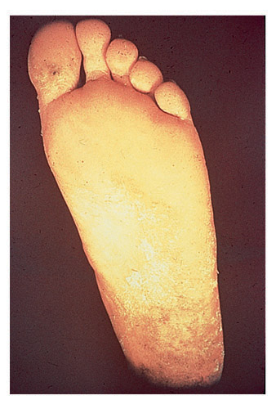
Disorders of the integumentary system
Athlete’s foot
What causes athlete’s foot?
  Fungus: Tinea Pedis
s/s: skin eruptions that may crack or form small blisters between toes, scaling skin
How is it treated?
  Clean/dry area thoroughly, antifungal agent (topical cream, powder, etc.)

Slide 17
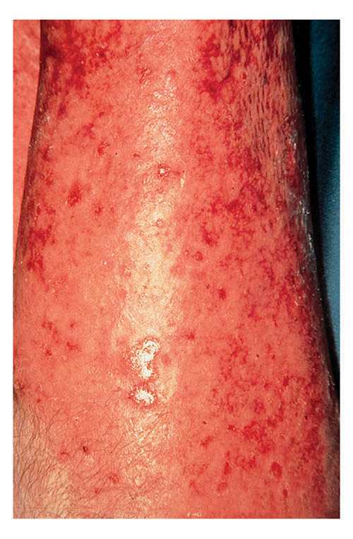
Disorders of the integumentary system
Burns:
First-degree
Second-degree
Third-degree

Slide 18
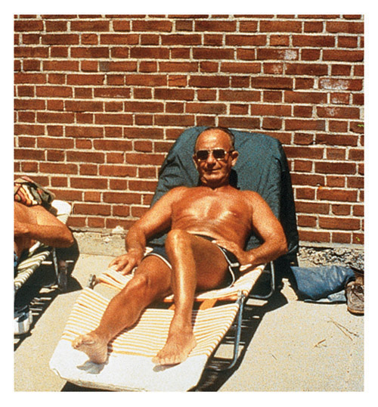
Disorders of the integumentary system
Burns:
First-degree
superficial

Slide 19
Disorders of the integumentary system
Burns:
Second degree
Partial thickness

Slide 20
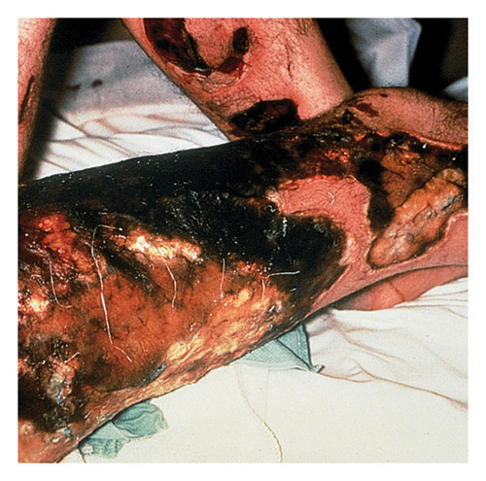
Disorders of the integumentary system
Burns:
Third-degree
Full thickness

Slide 21
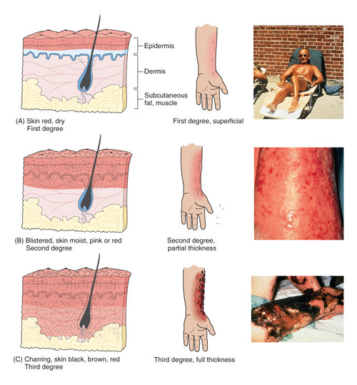
Disorders of the integumentary system
Burns:
Compare the different degrees of burns.

Slide 22
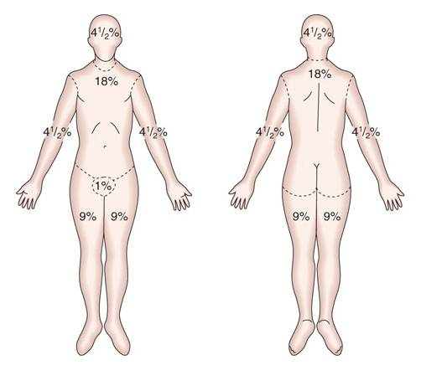
Disorders of the integumentary system
Burns:
Rule of Nines
Used to quickly assess percentage of body surface burned.
Can be used to determine extent of treatment needed.

Slide 23
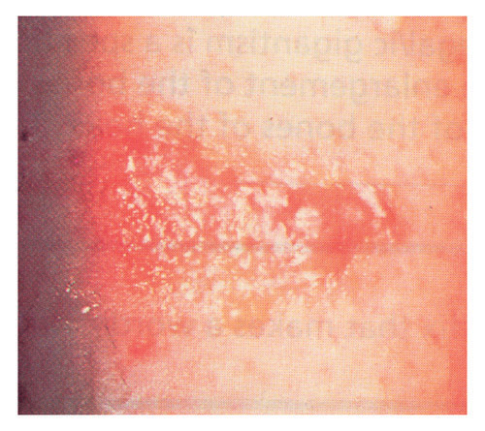
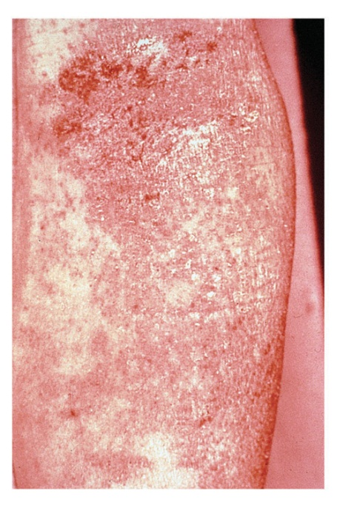
Disorders of the integumentary system
Dermatitis/Eczema
dermat- -itis
How are dermatitis and eczema similar?
  Symptomatically similar (redness, irritation, itching)
How are they different?
  Dermatitis is non-specific, Eczema can be acute or chronic
  Eczema will typically cause scaly or peeling skin
What is the treatment?
  Wash the area of the irritant, apply topical ointment to treat inflammation/itching

Slide 24
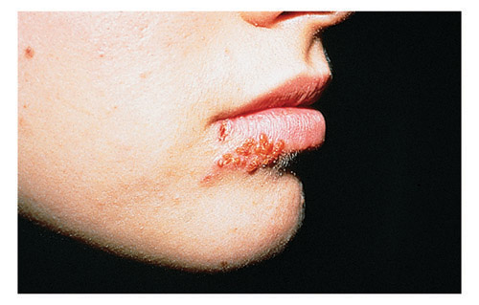
Disorders of the integumentary system
HerpeS Simplex Virus
Aka cold sores
HSV type 1 HSV type 2
What are the symptoms?
  Tingling, itching, blisters, oozing/crusting,
How is it spread?
  Oral contact
What is the prognosis?
  Treat symptomatically, may be recurring

Slide 25
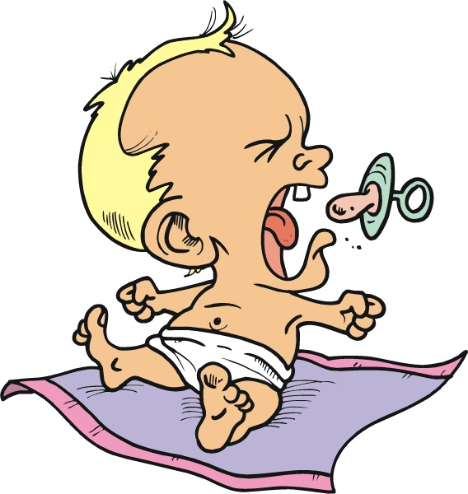
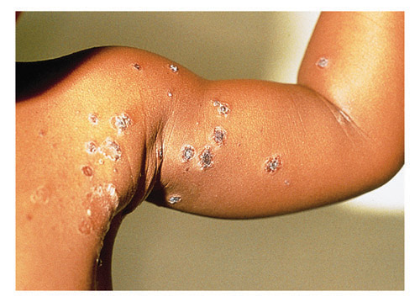
Disorders of the integumentary system
Impetigo
What are some risk factors in contracting impetigo?
  Common in ages 2-6
  Sports Participation (football, wrestling, skin to skin contact)

Slide 26
Disorders of the integumentary system
Impetigo
What two bacteria cause impetigo?
  Staphylococcus or streptococcus
How is it treated?

Slide 27
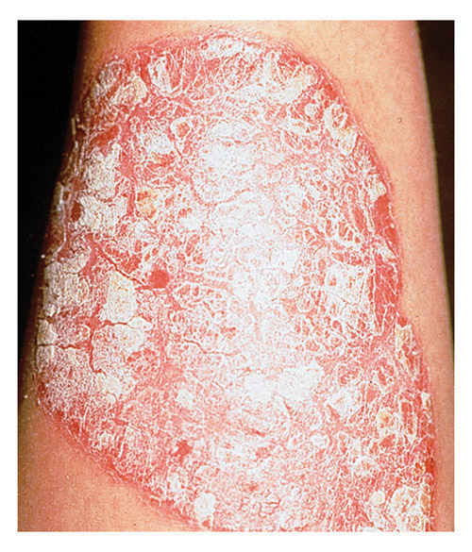
Disorders of the integumentary system
Psoriasis
Changes the cell cycle of skin
  Rapid build up of extra cells superficially
  Dry, reddish patches covered with silvery-white scales

Slide 28
Disorders of the integumentary system
Psoriasis
Who is likely to have psoriasis?
  Family history, viral/bacterial infections, obesity, smoking, stress
What is the treatment?
  No credible treatment
  Moisturizers recommended

Slide 29
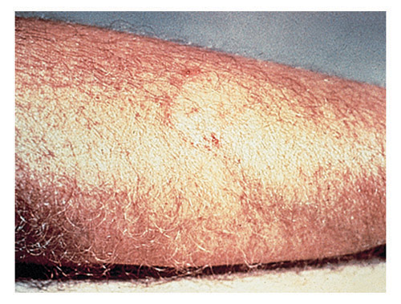
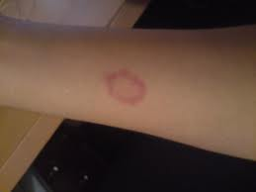
Disorders of the integumentary system
Ringworm
How is it spread?
  Direct contact
What causes ringworm?
  Fungus
What is the medical term?
  Tinea corporis
How is it treated?
  Antifungal medication
Two examples of ringworm
How would this be diagnosed?

Slide 30
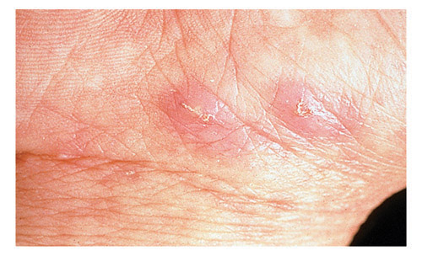
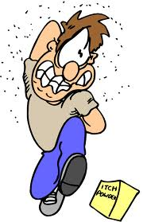
Disorders of the integumentary system
Scabies
What is the cause of scabies?
  Mites
Is it contagious?
  Yes, spreads through contact
How is it treated?
  Prescription medication
How is it prevented?
  Clean clothes/sheets/towels
  Starve the mites

Slide 31
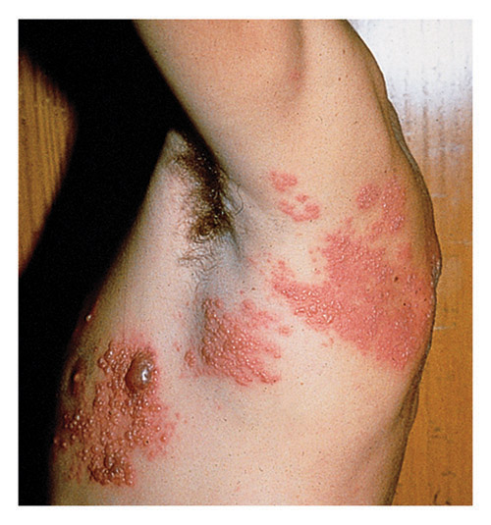
Disorders of the integumentary system
Shingles
What is the cause of shingles?
  Herpes Zoster
Is it contagious?
  Initially; once the rash crusts = no longer contagious
Who is most at risk?
  Over 50
  History of Chicken Pox
How is it prevented?
  Vaccine

Slide 32
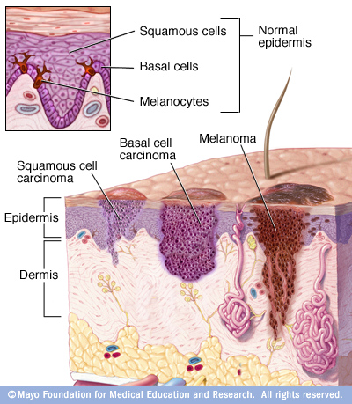
Disorders of the integumentary system
Skin cancer
What are the risk factors for developing skin cancer?
  Family history, UV Light
How can it be prevented?
  Sunscreen, protective clothing, avoid tanning beds
Three types:
  Basal cell carcinoma
  Squamous cell carcinoma
  Malignant melanoma

Slide 33
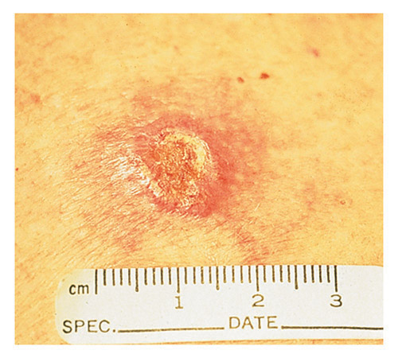
Disorders of the integumentary system
Skin cancer
Basal cell carcinoma
What is distinctive about this type of skin cancer?
  Most common, least malignant
Where does it usually form?
  On the face

Slide 34
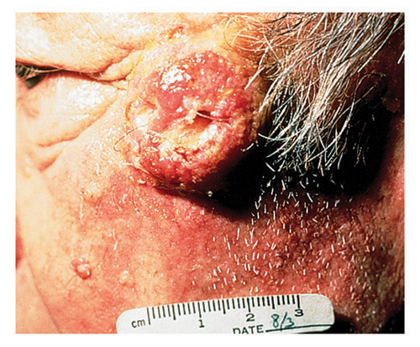
Disorders of the integumentary system
Skin Cancer
Squamous cell carcinoma
How is squamous cell carcinoma different from basil cell carcinoma?
  Grows rapidly, metastasizes to the lymph nodes

Slide 35
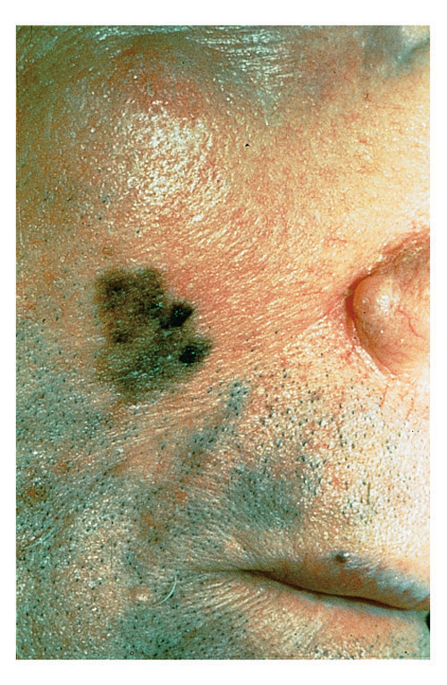
Disorders of the integumentary system
Skin cancer
Malignant melanoma
  How is malignant melanoma different from the other skin cancers?
    Occurs in the melanocytes
    Appears as black/brown, irregular patch; occurs suddenly
  How are skin cancers treated?
    Surgical removal, chemotherapy

Slide 36
Disorders of the integumentary system
Skin lesions:
Discuss the characteristics of the different skin lesions.

Slide 37
Disorders of the integumentary system
Skin lesions:
Compare these types of skin lesions.
Macule
Papule
Pustule
Ulcer
Vesicle

Slide 38

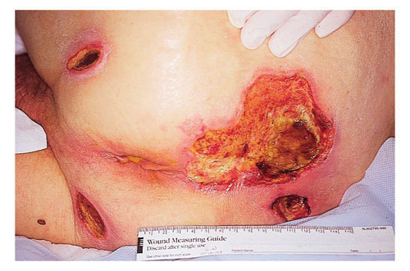
Disorders of the integumentary system
Skin lesion:
  Decubitus ulcer
Aka bedsores
How can they be prevented?
  Repositioning
  Specialized mattress
  Use cushions

Slide 39
Disorders of the integumentary system
Skin lesion:
  Decubitus ulcer
How are they treated?
  Repositioning (Decrease pressure)
  Cleaning/debridement
  Pain management
  Possible surgery

Slide 40
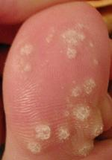
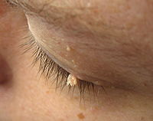
Disorders of the integumentary system
warts
What causes warts?
  HPV
Are they contagious?
  Possibly, depending on the cause
Can they be prevented?
  Prescription medication
  Cryotherapy
There are many different types!

Slide 41
Essential Questions:
What are the functions of the integumentary system?
What are some disorders of the integumentary system?
How are integumentary system disorders treated?
How do you relate the integumentary system to the body’s communication systems?

