Slide 1
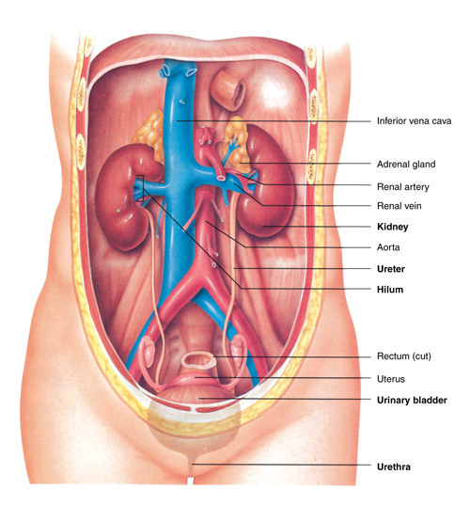
4.02 Understand the Functions and Disorders of the Urinary System

Slide 2
4.02 Understand the functions and disorders of the urinary system
Essential Questions
What are the functions of the urinary system?
What are some disorders of the urinary system?
How are disorders of the urinary system treated?
How do you relate the body’s hormone control to the urinary system?

Slide 3
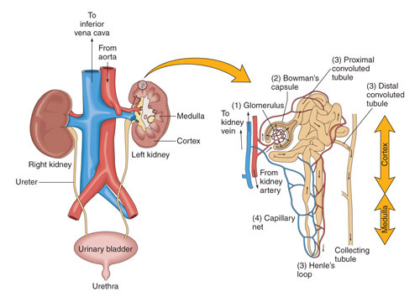
Understand the functions of the urinary system
Functions:
Excretion
Formation of urine
Fluid and electrolyte balance
Elimination of urine

Slide 4
Understand the functions of the urinary system
Excretion
What is excretion?
  Process by which nitrogenous waste material, certain salts, and excess water are removed from the blood
Why does the body have excretory functions?
  WASTE material (i.e. unnecessary, excess, maybe potentially harmful)

Slide 5
Understand the functions of the urinary system
Excretion
What is the composition of wastes excreted by the urinary system?
  Nitrogenous waste material, certain salts, and excess water (together in the form of urine)

Slide 6

Understand the functions of the urinary system
Filtration
Reabsorption
Secretion

Slide 7
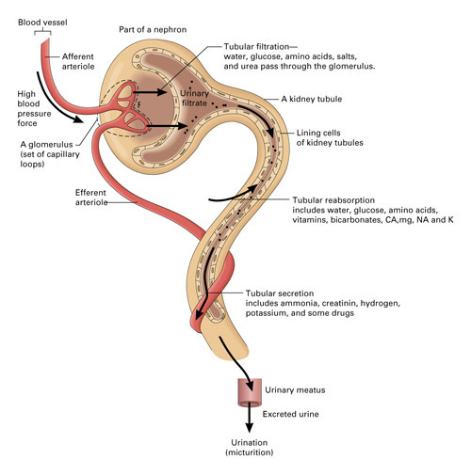
Filtration
Blood from renal artery enters glomerulus
High pressure in glomerulus forces fluid into Bowman’s capsule, where it is filtered

Slide 8
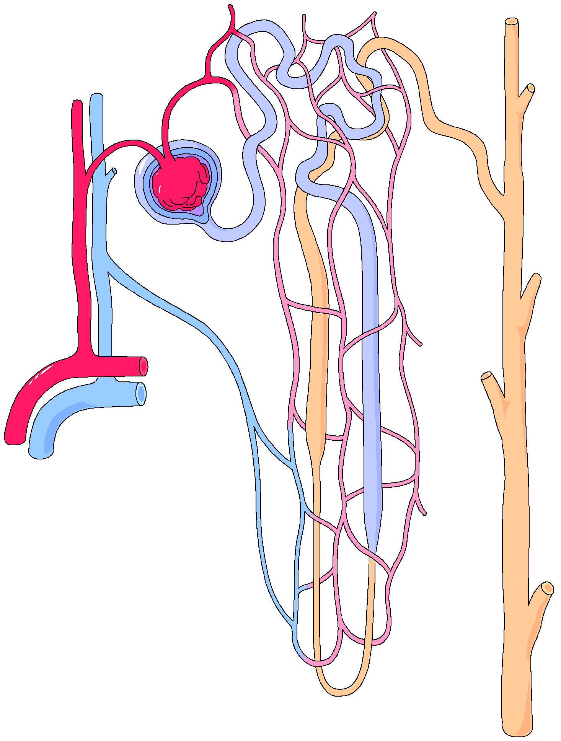
Filtration
BOWMAN’S CAPSULE
Bowman’s capsule filters out 125cc of fluid/min.
  What is 1cc equivalent to?
  How many cc’s per hour is this?
As the filtrate continues through nephron, 90% of water is reabsorbed—what would happen if reabsorption here failed?

Slide 9
Reabsorption
What substances are reabsorbed?
  Water, glucose, amino acids, bicarbonate ion and chloride salts of Ca, Mg, Na, and K
If blood levels of certain substances are high, the substances will not be reabsorbed.
How does this help maintain homeostasis?
  Works to maintain acid-base (pH) balance through selective reabsorption

Slide 10
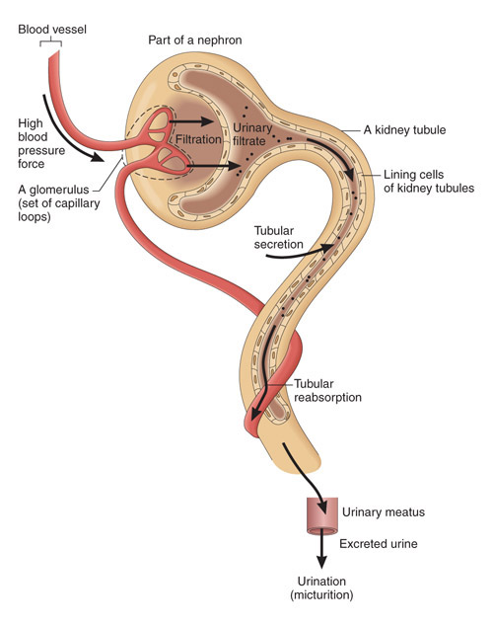
Secretion
What is secretion?
-the process when substances are transported into the distal tubules.

Slide 11
Secretion
Describe how this process is the opposite of reabsorption….

Slide 12
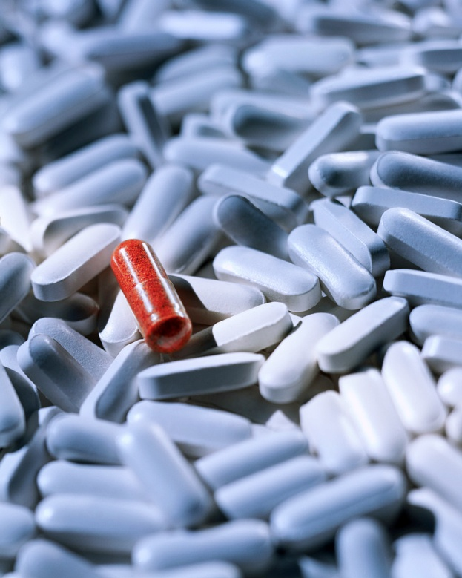
Secretion
What substances are secreted into the collecting tubules?
  Ammonia
  Creatinine
  Hydrogen ions
  Potassium ions
  Some drugs

Slide 13
Understand the functions of the urinary system
Fluid and electrolyte balance
Electrolytes are selectively secreted to maintain body’s acid-base balance.
  What are electrolytes?
  What do they do?
  What is the relevance to health?

Slide 14
Understand the functions of the urinary system
Fluid and electrolyte balance
Chemical control
  ADH- Antidiuretic Hormone
  Aldosterone
Nervous control

Slide 15
Understand the functions of the urinary system
Fluid and electrolyte balance
Chemical control
  ADH – Antidiuretic hormone
  Aldosterone

Slide 16
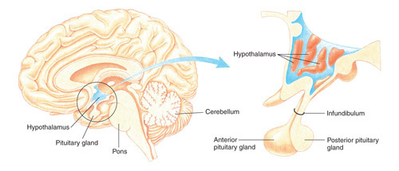
Understand the functions of the urinary system
Fluid and electrolyte balance
Chemical control
ADH is released by the posterior pituitary gland

Slide 17
Understand the functions of the urinary system
Fluid and electrolyte balance
Chemical control
What is the function of ADH (antidiuretic hormone)?
  Sensitive to osmotic pressure
  Signals reabsorption of water

Slide 18
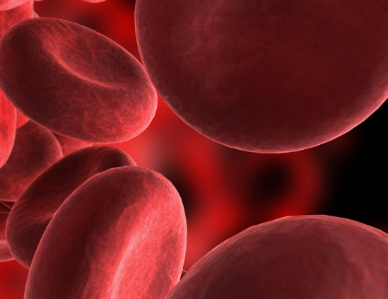

Understand the functions of the urinary system
Fluid and electrolyte balance
Chemical control
The amount of ADH produced is related to the level of body hydration
What factors regulate the release of ADH?
  Temperature (ambient, illness/fever)
  Exercise (this could have to do with temp-how)
  Drugs (diuretics)
  Alcohol (inhibits secretion from pituitary)

Slide 19
Understand the functions of the urinary system
Forming more dilute urine:
Define “dilute urine”
What are diuretics?
  Inhibit the reabsorption of water
What effect do they have on the production of urine?
Give examples of substances that have diuretic effects.
  Coffee/caffeinated beverages, apple juice, asparagus, chocolate, cucumber, pineapple, grapes, cherries

Slide 20
Understand the functions of the urinary system
Fluid and electrolyte balance
Chemical control
Aldosterone
Where does it come from?
  secreted by the adrenal cortex
What does it do?
  Promotes excretion of K and H ions, the reabsorption of K and H ions, and the reabsorption of Na and Cl ions and water
Aldosterone release is the result of the renin-angiotensin system. What does this mean?
  RENIN is a hormone released by the kidneys into the bloodstream in response to low blood pressure. It stimulates the release of aldosterone by the adrenal cortex (causing the blood vessels to constrict).

Slide 21
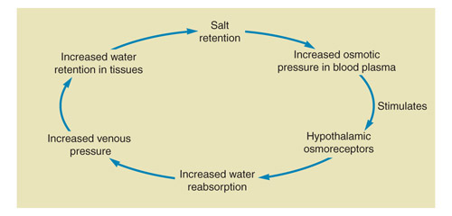
Understand the functions of the urinary system
Fluid and electrolyte balance
What effect does this cycle have on your blood pressure?

Slide 22
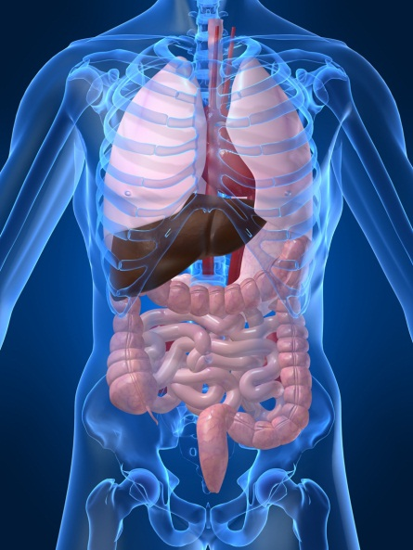
Understand the functions of the urinary system
Fluid and electrolyte balance
Nervous control
How does the nervous system control urinary secretions?
  accomplished directly through the action of nerve impulses on the blood vessels leading to the kidney and on those within the kidney leading to the glomeruli.
What other systems are involved in the production and excretion of urine?
  Endocrine system (indirectly)

Slide 23
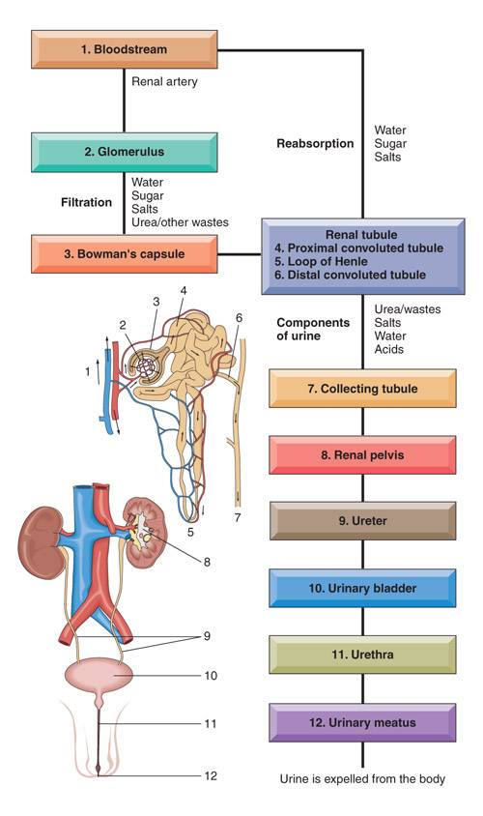
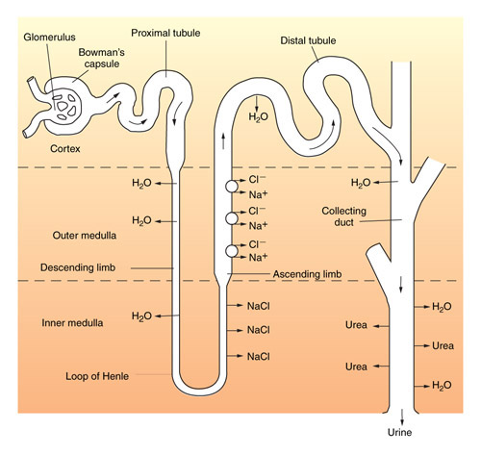
Understand the functions of the urinary system
The flow of electrolytes
Review urine formation, electrolyte exchange, and some factors that effect urine volume.

Slide 24
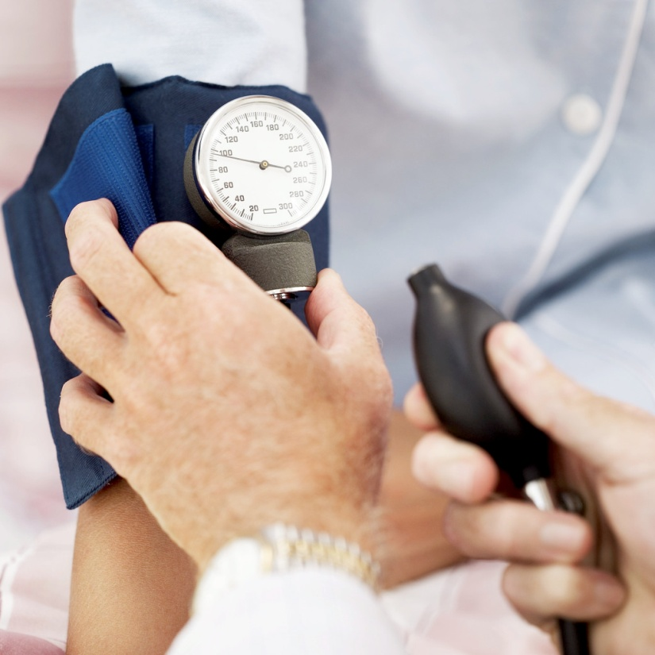
Understand the functions of the urinary system
review
What do you predict will happen to blood pressure when the blood volume increases?
What if blood
volume decreases?

Slide 25

Understand the functions of the urinary system
review
If more water is reabsorbed back into the body---what will happen to urine concentration?
(more or less concentrated?)

Slide 26
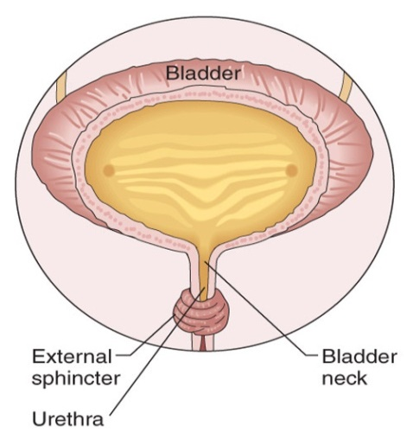
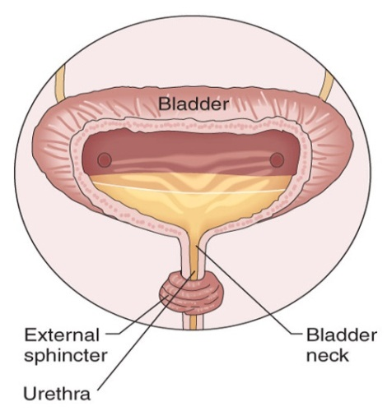
Understand the functions of the urinary system
Elimination of urine
What causes the bladder to empty?
-contraction of muscles forcing sphincter open
Is this a voluntary or involuntary action?
-yes (why?)

Slide 27
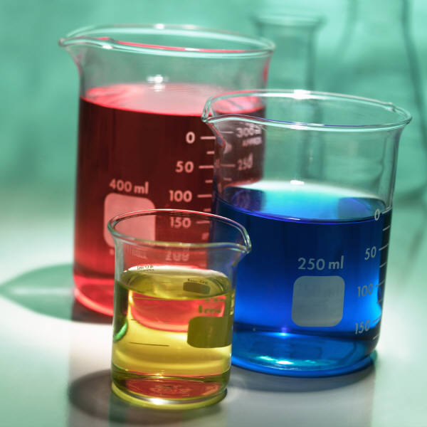
Understand the functions of the urinary system
Elimination of urine
Urinary output
Average urinary output = 1500 ml per day
What effects the color of your urine?

Slide 28
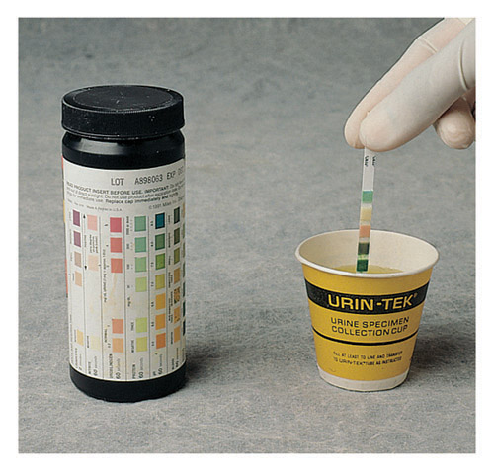
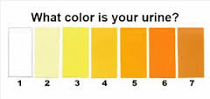
Urinalysis
An examination of urine
What does normal urine look like?

Slide 29
Urinalysis
An examination of urine
What constitutes a normal urinalysis?
      Physical characteristics
        Color
        Clarity
        Odor
      Normal values:
        Ph: 4.5-7.5
        Specific gravity 1.01 – 1.025
        No chemicals should be present

Slide 30
Urinalysis
What could the presence of blood in urine indicate?
What is the medical term for this condition?

Slide 31
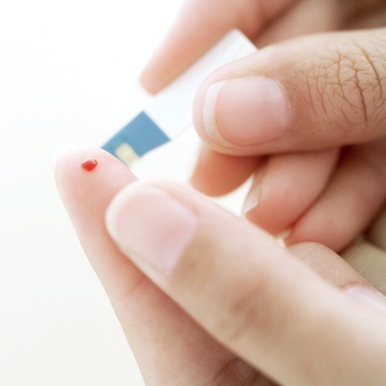
Urinalysis
Where would excess glucose show up?
What does this mean?

Slide 32
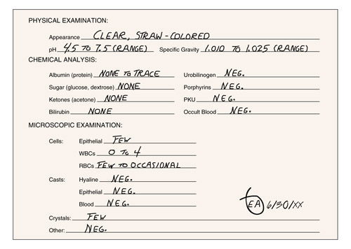
Urinalysis

Slide 33
Disorders of the urinary system

Slide 34
Disorders of the urinary system
Cystitis
What is cystitis
(cyst= medical term for ____ +itis =___ )
Most common cause: E. Coli
What are the major symptoms of cystitis?

Slide 35
Disorders of the urinary system
Cystitis
s/s
  A strong, persistent urge to urinate
  A burning sensation when urinating
  Passing frequent, small amounts of urine
  Blood in the urine (hematuria)
  Passing cloudy or strong-smelling urine
  Pelvic discomfort
  A feeling of pressure in the lower abdomen
  Low-grade fever

Slide 36

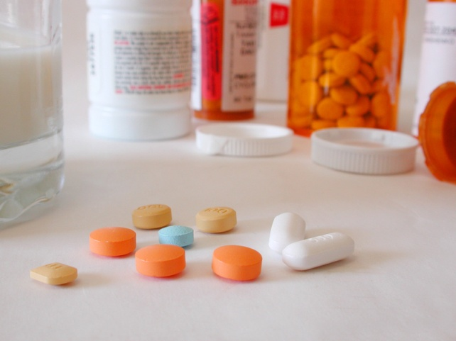
Disorders of the urinary system
Cystitis
More common in females—Why ??
Rx=
antibiotics

Slide 37
Disorders of the urinary system
Disease which injures the glomerulus.
What will happen as a result of damaged glomeruli?
Glomerulonephritis

Slide 38
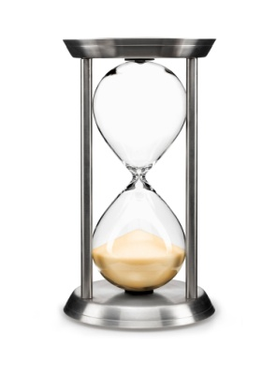
Disorders of the urinary system
Glomerulonephritis
Two types:
  Acute
  Chronic
Define these terms.
How do these terms relate to glomerulonephritis symptoms?
What is the prognosis for each?

Slide 39
Disorders of the urinary system
Glomerulonephritis
  hematuria
  Foamy urine (proteinuria)
  hypertension
  Fluid retention (edema) with swelling evident in your face, hands, feet and abdomen
  Fatigue from anemia or kidney failure
What is the prognosis for each?

Slide 40
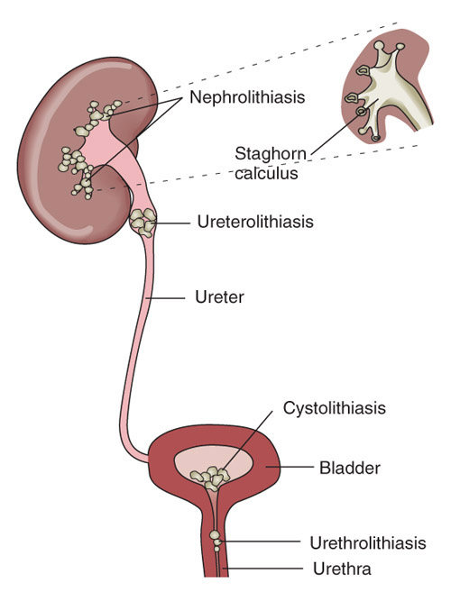
Disorders of the urinary system
Renal calculi
Also known as nephrolithiasis
nephro lith iasis
What are renal calculi made of?
What are the symptoms?

Slide 41
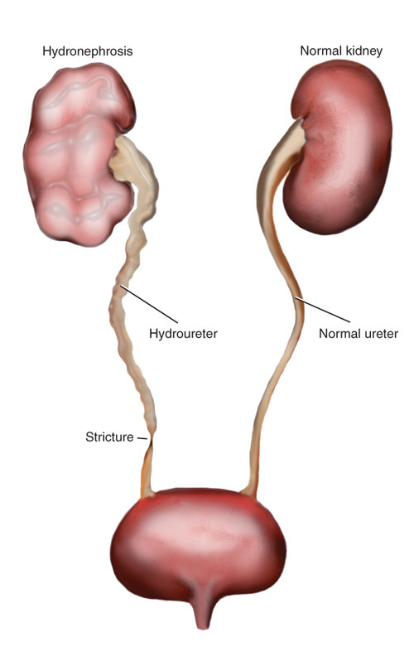
Disorders of the urinary system
Renal calculi
What will happen if the ureters are blocked?

Slide 42
Disorders of the urinary system
Renal calculi
How is it treated?

Slide 43
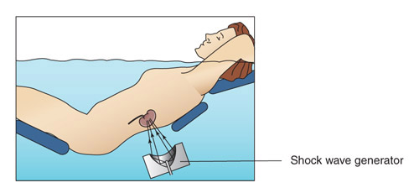
Disorders of the urinary system
Renal calculi
How does lithotripsy work?
Is it a cure?

Slide 44
Disorders of the urinary system
Renal failure
Acute
  What causes it?
    Nephritis, shock injury, poisoning
  What are the symptoms?
    Headache, dyspnea, n/v, possible death

Slide 45
Disorders of the urinary system
Renal failure
chronic
Gradual loss of function in the nephrons
  s/s include symptoms of acute renal failure and loss of appetite, fatigue, mental confusion, hiccups, clotting disorder, seizures

Slide 46
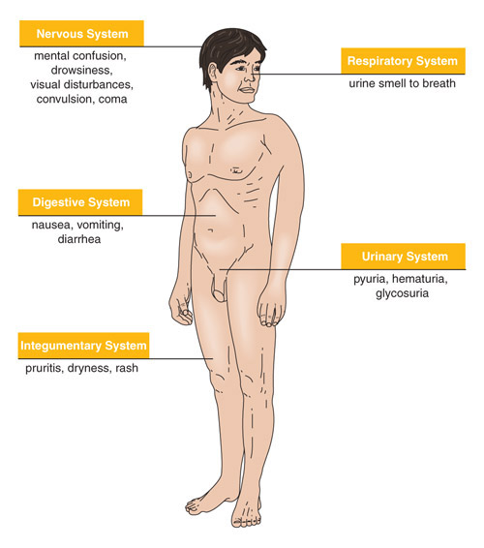
Disorders of the urinary system
Renal Failure
Chronic kidney disease leads to a buildup of fluid and waste products in the body.
How are these systems affected by renal failure?

Slide 47
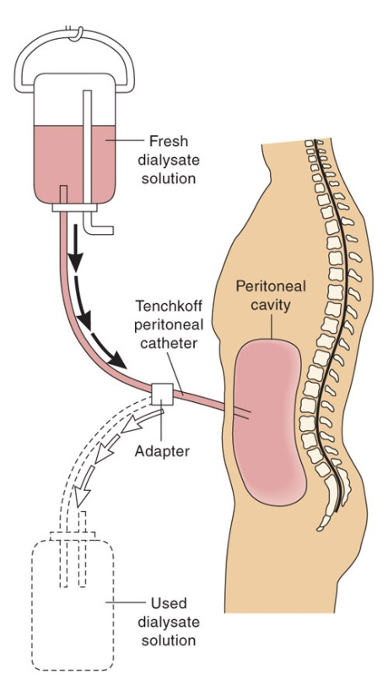
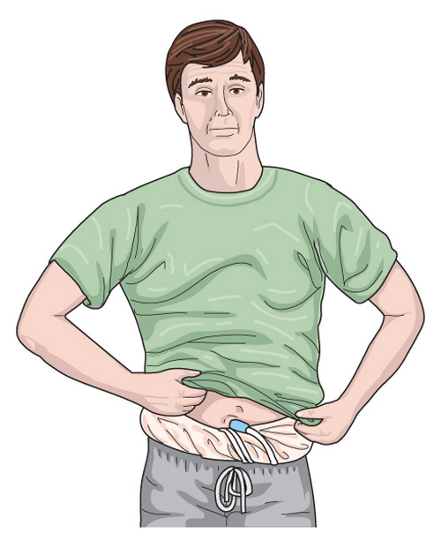
Disorders of the urinary system
Renal Failure
How is it treated?
  Peritoneal dialysis
  What is the process involved in this treatment?

Slide 48
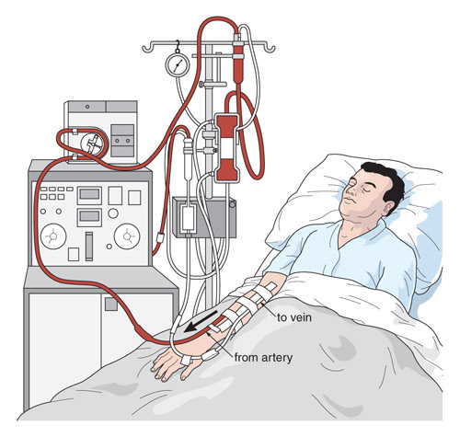
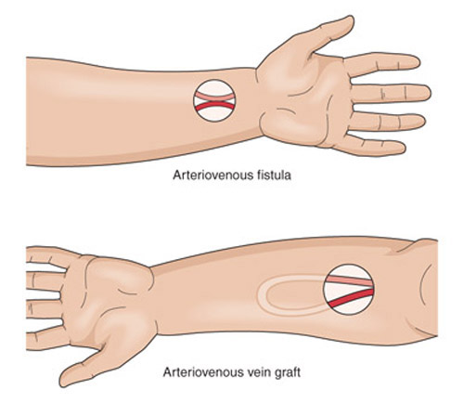
Disorders of the urinary system
Renal Failure
How is it treated?
  Hemodialysis
  What is hemodialysis?
  What determines the patient’s treatment schedule?

Slide 49

Disorders of the urinary system
Renal Failure
Compare the treatment of acute and chronic renal failure.

Slide 50

Disorders of the urinary system
How does hemodialysis mimic
glomerular function?

Slide 51

Disorders of the urinary system
Renal transplant
What is involved in this treatment option?
When does a patient get a transplant?

Slide 52
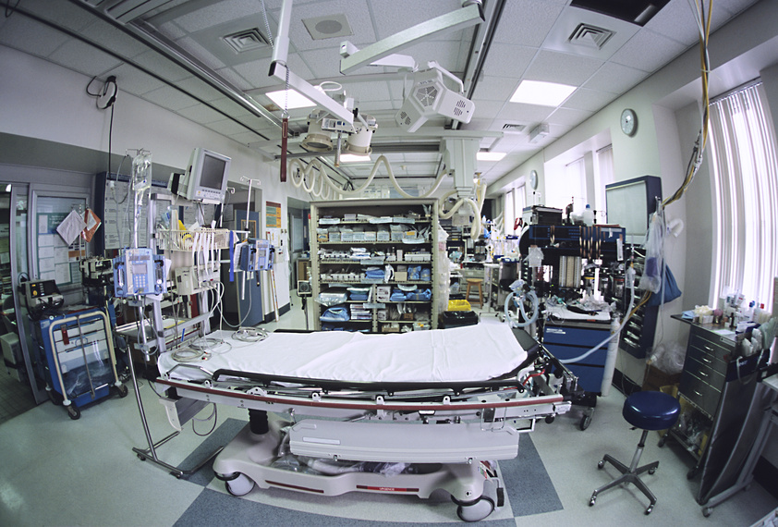
Disorders of the urinary system
Renal transplant
What is the major complication of renal transplantation?

Slide 53
4.02 Understand the functions and disorders of the urinary system
Essential Questions
What are the functions of the urinary system?
What are some disorders of the urinary system?
How are disorders of the urinary system treated?
How do you relate the body’s hormone control to the urinary system?

