Slide 1
Biomedical Research
Examining types of biomedical research methods, their benefits
and limitations

Slide 2
Lesson Objectives
Describe the five types of Biomedical Research, and the strengths and limitations of each.
Identify the three phases of the clinical trial and the steps that follow to receive FDA approval.
Describe the three types of epidemiological studies
Identify the strengths and limitations of epidemiological studies

Slide 3
Biomedical Research Methods
5 Main Methods:
Chemical, Mechanical, Mathematical and Computer Simulations
In vitro tests
Non-human models (animals)
Human Studies
Epidemiological Studies

Slide 4
Chemical, Mechanical, Mathematical and Computer Simulations
Used most often in basic stage of research
Strength
Good to use because they are usually faster and more efficient than other method
Limitation
Not good because they cannot completely replicate the response a living organism might have

Slide 5
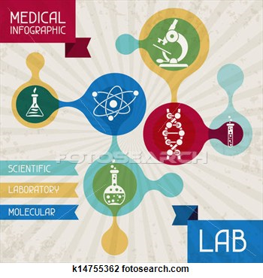
In Vitro Tests
In vitro tests are experiments performed in laboratory containers using tissues and cells
Translation of In Vitro is “in glass”
Most useful in basic and applied stages of research

Slide 6
In Vitro Tests
Strengths
Makes it easier to study a single effect of a substance in isolation (no interference from other bodily functions: hormones, immune system, enzymes, etc.)
It has been used extensively in study of viruses
Limitations
Cannot tell how a substance affects a complex animal system

Slide 7
Non-human models
Strengths
Animals provide the best known surrogate for humans in the lab
Similarities between animals and humans outweigh differences
Limitations
Not identical to humans
Research animals are expensive to purchase, feed and provide vet care for
Costly federal regulation system

Slide 8
Human Studies
Most often used in developing prescription drugs
Pharmaceutical firms must file an application with the FDA before they can begin any clinical trials involving humans
The first application to the FDA is called a IND (Investigational New Drug)
Once the IND is approved clinical trials with humans may begin

Slide 9
Clinical Trial Phases
Phase I
Phase II
Phase III

Slide 10
Clinical Trials
Phase I :Researchers determine a drug’s interaction with the human system, how it is absorbed, distributed and likely duration of its therapeutic effect. This phase takes about one year. Small numbers of healthy people used

Slide 11
Clinical Trials
Phase II: Controlled tests conducted that help determine the drug’s effectiveness. 100-300 volunteer patients involved. Both animal and human tests occur at the same time during this stage to assess the safety of the drug. This phase takes approximately two years.

Slide 12
Clinical Trials
Phase III: Conducted to confirm the results of earlier tests and further identify any adverse reactions. Involves 1000-3000 volunteer patients in medical clinics and hospitals. This phase takes approximately three years

Slide 13
Clinical Trial Phases lead to:
Once the three phases have been completed:
The pharmaceutical/device firm applies to the FDA again:
This application is called a NDA (New Drug Application) or IDE (investigational device exemption). There is a time frame of about 2 ½ years for this application and all data required to be completed and approved by the FDA.

Slide 14
Clinical Trial Phase Summary
Currently, it takes approximately 12 years from initiation of animal and other laboratory studies through all phases of clinical trials to submission of data to the FDA for approval!!

Slide 15
Steps to FDA approval to bring drugs to the market
 |  |  |  |  |  | FDA approval |  |  | Total 12 years
 |  |  |  |  | FDA review |  |  |  |  | 2.5 years
 |  |  |  | Phase III clinical studies |  |  |  |  |  |  | 3 years
 |  |  | Phase II clinical (effectiveness) studies |  |  |  |  |  |  |  |  | 2 years
 |  | Phase I clinical (safety) studies |  |  |  |  |  |  |  |  |  |  | 1 years
 | Laboratory and animal studies |  |  |  |  |  |  |  |  |  |  |  |  | 3.5 years

Slide 16
Clinical Trial Phases Summary
Strengths of clinical trials :
Actual human data.
Limitations of clinical trials
Ethical and moral considerations limit the extent to which human volunteers can be used as test subjects for a potential new drug.

Slide 17
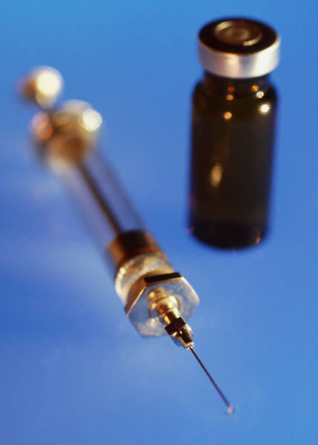
Epidemiological Studies
Types:
Experimental epidemiology
Descriptive epidemiology
Observational epidemiology

Slide 18
Experimental Epidemiology
Experimental epidemiology is the human equivalent of animal testing
Providing or withholding a substance to determine its toxic or beneficial effects
Such studies are greatly limited for ethical and legal considerations (ie: Tuskegee study)
There is difficulty involved in securing the cooperation of a large number of participants

Slide 19
Descriptive Epidemiology
Analyzes data on the distribution and extent of health problems or other conditions in various populations
Tries to find correlations among characteristics such as diet, air quality and occupation
Such comparisons are frequently made between countries and smaller geographic regions

Slide 20
Observational Epidemiology
Uses data derived from individuals or small groups
Data is evaluated statistically to determine the strength of association between a particular variable and disease

Slide 21
Strengths of Epidemiological Studies
Epidemiological studies offer scientists a direct opportunity to study the effects in humans exposed to chemicals and disease-causing organisms.
These studies are also useful in identifying patterns in disease or injury distribution. These patterns may be traced to causative factors.

Slide 22
Limitations of Epidemiological Studies
A major disadvantage of epidemiological studies is that considerable human exposure can take place before a toxic effect is detectable, particularly in the case of diseases like cancer that take many years to develop
It is also difficult to demonstrate a direct cause-and-effect relationship between a specific exposure and disease
There are limited methodologies to measure or verify such things as an individual’s prior exposure, route of exposure or extent of exposure to a causative agent.

Slide 23
Examples of epidemiological studies:
Black Plague (14th century): the study established that the plague was spread from rats to humans via fleas.
Cholera outbreak (1854): John Snow conducted and epidemiologic study and contaminated water pump.
Hammond-Horn Smoking Study (1952): the American Cancer Society decisively demonstrated the effect of cigarette smoking on death rates from cancer and other diseases.

Slide 24
Assessing your knowledge:

Slide 25
1. What are the 5 main types of research methods?

Slide 26
Answer:
5 Main Research Methods are:
Chemical, Mechanical, Mathematical and Computer Simulations
In vitro tests
Non-human models
Human Studies
Epidemiological Studies

Slide 27
2. What research method is described in this example?
Working in a lab setting creating a new antibiotic is an example of:
Chemical, Mechanical, Mathematical and Computer Simulations
In vitro tests
Non-human models
Human Studies
Epidemiological Studies

Slide 28
Answer:
In vitro tests

Slide 29
3. Clinical trials are conducted:
On humans
On animals
In Vitro
With computer models

Slide 30
Answer:
Clinical trials are conducted on humans.

Slide 31
4. Which Clinical Trial phase is conducted on a small sample of healthy patients?
Phase I
Phase II
Phase III
Post marketing study

Slide 32
Answer:
Phase I

Slide 33
5. Which clinical trial phase involves a large patient group (1000+) and confirms the findings of the earlier phase while assessing adverse reactions?
Phase I
Phase II
Phase III
Post marketing study

Slide 34
Answer:
Phase III

Slide 35
6. How long does it take to receive FDA approval to market a drug in the USA?
5 years
8 years
10 years
12 years

Slide 36
Answer:
12 years

Slide 37
7. What types of Epidemiological studies are there?
Experimental
Descriptive
Observational
All of the above

Slide 38
Answer:
All of the above

Slide 39
8. The EBOLA outbreak in regions of Africa, is being studied for patterns of disease and its distribution.
This is an example of which type of Epidemiological study?
Experimental
Descriptive
Observational

Slide 40
Answer:
Descriptive

Slide 41
Mystery Disease Activity
Class to brainstorm on:
Name a mystery disease
Is it population specific?
What are the symptoms?
Research teams will decide on:
how we discovered the disease
how we can cure the disease.

Slide 42
Mystery activity research teams
Each group is a biomedical research team. While considering a cure, you must determine:
How the disease is spread
Will testing need done to confirm this?
Where could you gather info on similar diseases?
What BM research methods will you use?

Slide 43
Mystery disease activity questions for research groups:
Regarding BM research methods:
If you choose computer models, in what ways will the computers be used?
If you choose to use in vitro studies, what types of cells or tissues would you analyze?
If you decide on animal studies, what type of animal and how many do you want to use?
If you suggest clinical trials, include the methods that must take place before conducting the clinical studies.
If you choose epidemiological studies, how might the information be gathered?

Slide 44
Research teams will present their findings to the class.
Discuss the success of the researchers in discovering the illness
Identify the method used to develop a cure
Explain how the methods chosen are related to the characteristics of the mystery disease

