Slide 1
Career in Biomedical Technology Objective 2
Imaging Careers & Technology

Slide 2
Part 1: Medical Imaging
Radiological imaging is no longer limited to
the use of x-rays. It now includes
technology-intensive imaging with high
frequency sound waves, magnetic fields,
and radioactivity.
Teleradiology is a relatively new facet of medical imaging.

Slide 3
Careers in Medical Imaging
In the field of medical imaging the
major careers are:
Radiologist
Radiologic Technologist
Nuclear Medicine Technologist
Ultrasound Technologist

Slide 4
Radiologist
To be a radiologist you must complete an undergraduate degree, medical school and 5 years of additional specialized training beyond medical school.
Radiologists are physicians who read and interpret
results of all imaging studies and are in charge of the
Department of Radiology in the facilities they work in.

Slide 5
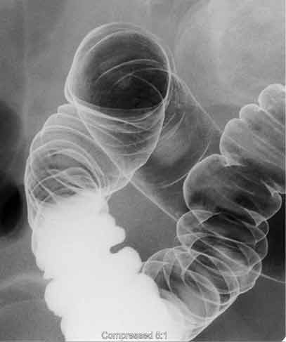
Lower GI Tract X-ray
A radiologist correlates
medical image findings with other examinations
and tests, recommends further examinations
or treatments, and confers with referring
physicians.
This image shows the right side of the large intestine. Air (dark) distends the bowel and barium (white) coats the inner lining.

Slide 6
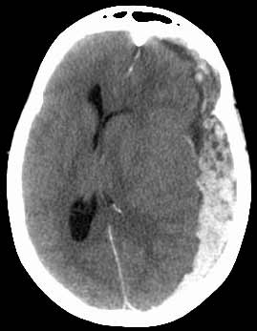
CT Scan of the Brain
Recent bleeding
(subdural hematoma) in
an injured patient is
seen as a bright mass
that is pushing the
brain to the other
side.

Slide 7
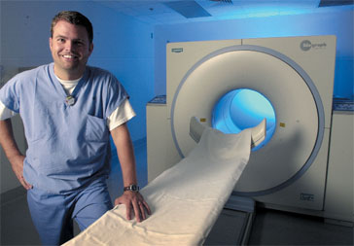
Radiologic Technologist
Radiology Technologists operate the radiographic equipment to produce images. The technologist also moves the imaging equipment into position and adjusts equipment controls to set exposure based on knowledge of the procedure and on established guidelines.

Slide 8
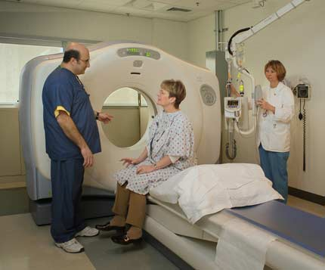
Radiological technologist explain procedures to the patients.

Slide 9
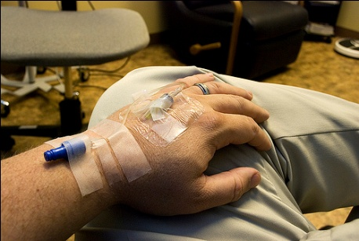
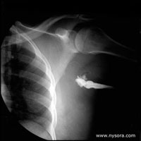
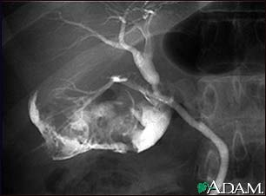
Radiologic technologist administers radio opaque dye Radiological Technologist who have had additional training can administer radio-opaque dye into the patient’s prior to specialized imaging scans.
Radio opaque dye in the brachial plexus sheath.
Gallbladder disease can be seen on a cholangiogram.
Radio-opaque dye is used to enhance the x-ray. Multiple stones are present in this gallbladder. (Cholecystitis)

Slide 10
Radiologic Technologist is also known as a Radiographer
The entry level requirement to be a
Radiologic Technologist is an Associates
Degree. Bachelor’s Degree is also
available.
Salary Range = $35,300 to $63,800

Slide 11
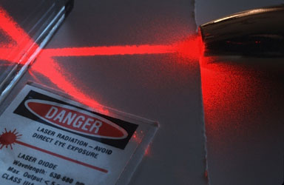
Radiation Exposure
Because radiation can be
harmful as well as helpful, the
Healthcare workers that work
in areas of potential radiation
exposure have to be protected.
The U.S.
Food and Drug Administration
(FDA) and other federal and
state agencies regulate medical
procedures that use radiation.

Slide 12
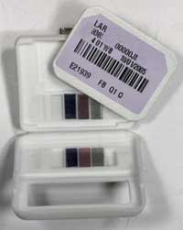
Film Badges
The film badge dosimeter, or film badge, is dosimeter used for monitoring cumulative exposure to ionizing radiation.
The badge consists of two parts:
photographic film, and a holder. The film
is removed and developed to measure
exposure.

Slide 13
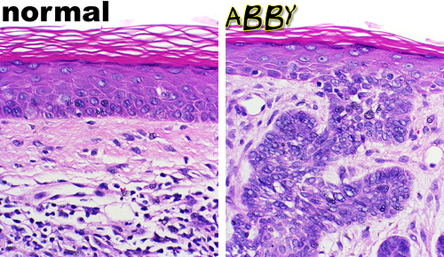
Nuclear Medicine
Nuclear medicine is a branch of medicine and medical
imaging that uses the nuclear properties of matter in
diagnosis and therapy.
More specifically, nuclear medicine is a part of
molecular imaging because it produces images that
reflect biological processes that take place at the
cellular and subcellular level.

Slide 14
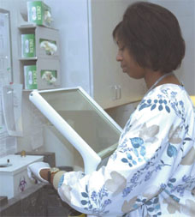
N.M.T. Nuclear Medicine Technologist
The time required for training differs
with the type of program
ranging from one to four years.
Programs can either be associate
degree (two year) or bachelor’s
degree programs (four year) or
certificate programs (one year).
Certificate programs most often require the applicant to be a
certified/registered or registry eligible clinical laboratory
scientist, radiologic technologist, nurse or medical technologist.
Salary Range:
$43,000.00 - $70,000.00

Slide 15
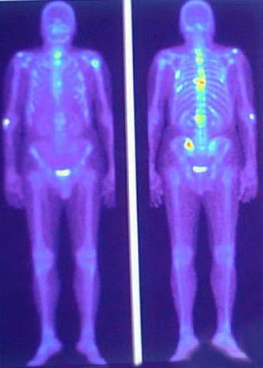
Nuclear Medicine Technologist Duties
* N.M.T.’s often perform brain, thyroid,
lung, bone scans and PET scans.
* N.M.T.’s administer radio opaque dye I.V. as
part of the scan procedure.
An example of a bone scan is shown above. The bone scan will reveal stress
fracture, fracture, infection or cancer in the bone or joints.

Slide 16
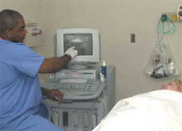
Ultrasound Technologist Also Known As Medical Sonographer or Diagnostic Medical Sonographer
Ultrasound Technologist
or Medical Sonographer
use sound waves
(ultrasound) to create
images that show the shape and
composition of body tissues, organs, and
pathologies.

Slide 17
Ultrasound Technologist Also Known As Medical Sonographer or Diagnostic Medical Sonographer
Sonographers are trained to do ultrasound on most any
bodily part or organ but some may specialize in the
following areas:
> Neurosonography (brain)
> Vascular sonography (blood vessels)
> Echocardiography (heart)
> Abdominal sonography (abdominal cavity)
> Obstetrics/gynecological sonography (female reproductive system)
> Ophthalmologic sonography (eye)

Slide 18
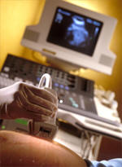
Ultrasound Technologist Also Known As Medical Sonographer or Diagnostic Medical Sonographer
Educational Requirements:
Associates Degree for general sonography
Bachelor’s Degree for specialization
Salary Range:
$40,000.00 - $75,000.00

Slide 19
Part 2: Related Imaging Personnel
Physicist
Medical Dosimetrist
Electrocardiograph Technician (EKG)
Echocardiography
Electroencephalograph Technician (EEG)

Slide 20
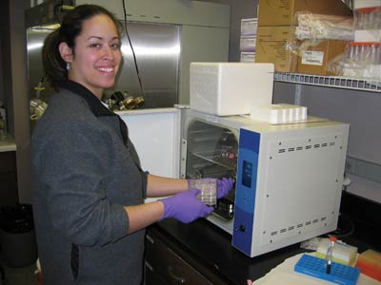
Physicist Also Known As Health Physicist
Health physics is a scientific discipline devoted
to the study of radiation and its effects on
living things.
Health Physicists
develop or implement
methods to evaluate
radiation hazards and
to protect
humans and the
environment from radiation.

Slide 21
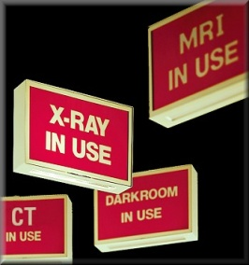
Physicist Also Known As Health Physicist
Physicist may study issues such as radioactive waste disposal, nuclear energy, indoor radon, and other potential hazards.
Health physicists who work in regulatory
enforcement establish guidelines for adequate
radiation control.

Slide 22
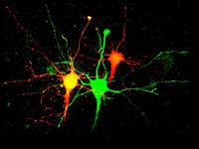
Physicist Also Known As Health Physicist
Educational Requirements:
Masters or PhD
Salary Range:
$56,000.00 - $90,000.00

Slide 23
Medical Dosimetrist
A dosimetrist is a member of a radiation
oncology team who specializes in the
operation of radiation equipment and
calculations of dosages in cooperation
with oncologists.

Slide 24
Medical Dosimetrist
Educational Requirements:
Bachelors or Masters
Salary Range:
$84,600 = median annual salary for a medical dosimetrist with 0-4 years of experience according to U.S. data taken in 2007

Slide 25
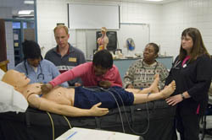
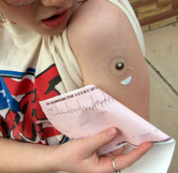
Electrocardiograph (EKG) Technician
Attaches electrode pads to the patient’s chest, arms and legs to test the electrical action of the heart.

Slide 26
Electrocardiograph (EKG) Technician
Educational Requirements:
1 year certification programs or 8 -16 weeks on-the-job training
Salary Range:
$21,700 to $29,800.

Slide 27
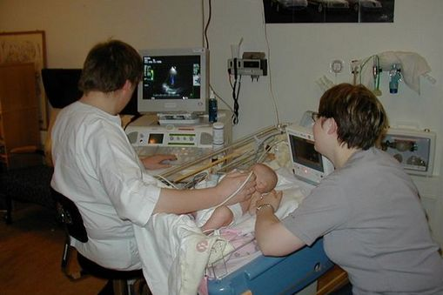
Echocardiograph Technician (also called Cardiac Sonographers)
Obtain two-dimensional
images of the heart, and
measure blood flow velocities
within the chambers of
the heart with special
equipment to direct high
frequency sound
waves into areas of the patient’s body.

Slide 28
Echocardiograph Technician (also called Cardiac Sonographers)
Educational Requirements:
Associates Degree
Salary Range:
$40,000 - $75,000

Slide 29
Electroencephalograph Technician (EEG)
An electroencephalogragh
is the recording of
electrical activity along
the scalp produced by the
firing of neurons within
the brain.
The EEG technician attaches
electrodes to the patients head,
operates specialized equipment and
assures quality results are obtained.

Slide 30
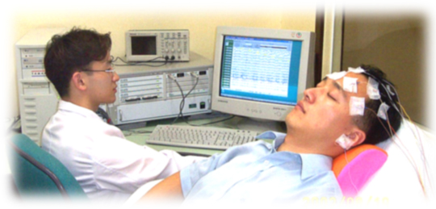
Electroencephalograph Technician (EEG)
An EEG is usually done
to assess patients
with conditions such
as seizure activity,
chronic or severe
headaches as well as to
determine level of
brain activity in coma
patients.

Slide 31
Electroencephalograph Technician (EEG)
Educational Requirements:
Associates or bachelor’s degree
Salary Range:
$25,000 - $75,000

