Slide 1
Diagnostic Services in Healthcare
www.ncabr.org/k12/curricula

Slide 2
What’s wrong with me?
Diagnostic procedures must be of high quality:
Must have reference ranges for:
Blood
Urinalysis
Cultures
Biopsy
Rapid diagnostic test technologies (strep test)

Slide 3
Quality standards also apply to
Imaging studies
Home medical test kits
Genetic tests

Slide 4
Careers in Diagnostic Medicine
Pathologists
Medical Laboratory Technologists
Medical Laboratory technicians
Nuclear medicine technicians
phlebotomists

Slide 5
What are my test results?
SOP:
standard operating procedures are a set of instruction which ensure that everyone performing a specific task or test follows the same steps for quality assurance
Clinical Lab Improvement Act (CLIA) first came out in 1988 and has been updated many times as best practices change.

Slide 6
CLIA
Stipulates that competent staff must be working in the lab setting. Competency must be established upon hire and verified at least annually or with any new technology implemented.
Classifies equipment by complexity of operation and establishes the competency needed to operate each.
Requires policy and procedures be written regarding the operation of the equipment - SOP

Slide 7
CLIA continued
Organizations must have calibrations, quality controls, and validations done periodically as stipulated by the complexity.
The process that will be followed for out of range values, alert values, etc.
All clinical are subject to unplanned surveys by CLIA representatives.

Slide 8
Write SOP for Kool Aid
Supplies needed
Steps
Timeframe
Etc.

Slide 9
Write SOP for Kool Aid
Supplies needed:
Pitcher
Spoon
Measuring cup
Water
Cool aid powder
Sugar
Paper towels

Slide 10
Cool Aid instructions
Follow recipe on back of the Cool Aid packet
Cut the measurement in half
Write the SOP:
Use details
State the supplies
Where they come from
How much of each item is mixed
The stir time
Etc.

Slide 11
How can I be sure my results are accurate?
SOPs are followed
How are “healthy samples” recognized?
What happens to the other samples?

Slide 12
SOP exercise

Slide 13
Why are urine tests done?
To detect urinary tract infections
Metabolic disorders (diabetes)
Kidney disorders

Slide 14
Three steps involved
Visual inspection of sample (should be yellow or clear)
Chemical tests using chemical strips (pH, proteins, glucose, ketones, etc)
If abnormal results are found, microscopic exam of the urine is done looking for microorganisms and crystals

Slide 15
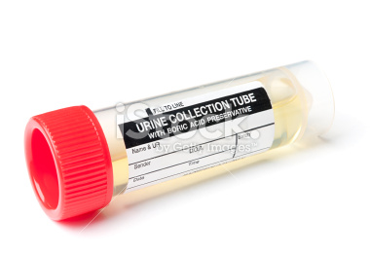
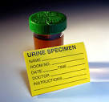
Perform a urinalysis on 3 samples
One healthy sample
two unhealthy samples
Each table: two people run samples, one person records the results, one person reports them

Slide 16
SOP # 1: Identify sample
Very important step is to ensure whose sample this is and have it labelled:
Name / ID number
Date
Time
Desired test to be run

Slide 17
SOP # 2: Infection control
Personal protective equipment
Gloves
Goggles
Clean surfaces pre/post analysis
Dispose of samples according to institutional P/P

Slide 18
Obtain sample
Important to give good patient instructions for a clean sample
Proper labelling should be a part of the instructions

Slide 20
Inspect urine samples for
Complete the worksheet chart for 3 samples commenting on:
Odor
Color
Clarity
Ketones
Glucose
Protein
Blood

Slide 21
Urinalysis test strips

Slide 22
Dip stick and evaluate results

Slide 23
Look at the following reagents

Slide 24
Recording results

Slide 25
Reporting the findings
Findings outside normal range requires:
Verify that P/P followed:
Were the strips read in a timely fashion?
Were they expired strips?
Etc.
Notification of health professional caring for the patient

Slide 26
Possible health issues revealed:

Slide 27
How does this apply to forensics?
What else could be analyzed in the urine?
What might be of interest in the blood?

