Slide 1
Organ Transplant Process
Cary High

Slide 2
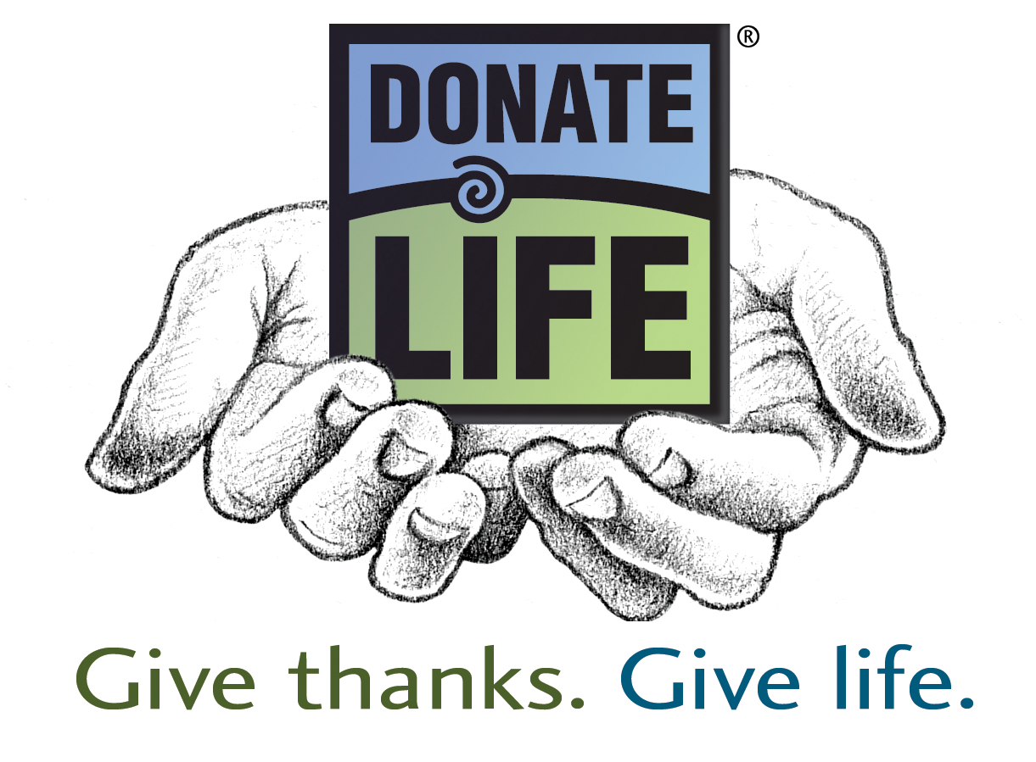
Who can register as a donor?
Everyone is eligible

Slide 3
How do I register as a donor?
At DMV: a red heart is placed on your license, indicating that you said “yes”
Online: DonateLife.org
Talk to your family about it.

Slide 4
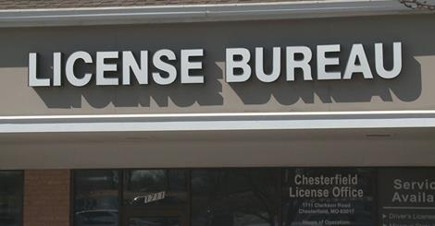

Slide 5
What is the NC Heart Prevails Law
It means that if you are 18 or older and are registered as a donor at the DMV or online, your wishes cannot be overturned by others.
This relieves the family from having to make this decision on your behalf in a time of stress.

Slide 6
What if I change my mind
The online donor record at DonateLife.org/register supersedes your DMV donor record
If you want to remove yourself, go to the NC Donor Registry and follow directions.

Slide 7
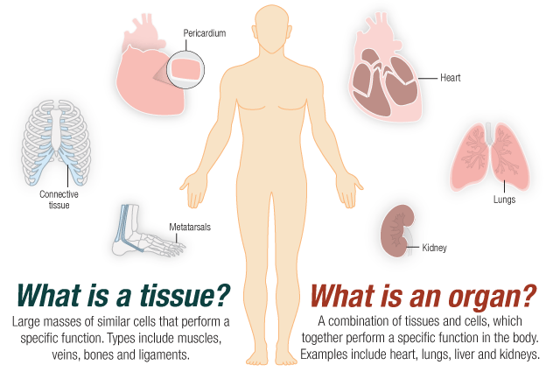

Slide 8
What organs can be donated?
Heart
Lungs
Liver
Pancreas
Kidneys
intestines

Slide 9
What tissues can be donated?
Skin
Bone
Corneas
Heart valves
veins

Slide 10
Who can be a donor?
Anyone, regardless of age, medical history or health habits
Organs have to have blood and oxygen to be suitable for transplant so typically only individuals die in the hospital ICU have the potential to be an organ donor.
Tissue and eye donation can occur when death occurs at home.

Slide 11
How does the process work?
Hospitals notify the Organ Procurement Organizations (OPOs) and Tissue/Eye Banks of a death.
If organ or tissue donation is a possibility, NC Donor Registry is checked to verify his/her wishes.
Staff from the agency meets with family to see if the person can be a donor.

Slide 12
How soon do organs and tissues need to be transplanted after recovery?
Heart / lungs 4-6 hours
Pancreas 12-24 hours
Liver 18-24 hours
Kidneys 48-72 hours
Bone / Skin Two – five years
Corneas Can be preserved 7-14 days

Slide 13
Is there a cost to my family if I am an organ/tissue donor?
No. All costs related to the donation of organs / tissues are paid for by the recipient’s insurance, Medicare or Medicaid.

Slide 14
Does my religion support organ / tissue donation?
Most organized religions do. It is considered an act of charity.

Slide 15
Will signing up on the donor registry affect the quality of medical care I receive?
Absolutely not. Medical care is always based on what is necessary to save a patients life.

Slide 16
How do they match donors and recipients for organ transplants?
The United Network for Organ Sharing (UNOS) coordinates this. They look at:
Blood and tissue type
Time on waiting list
Geographical location

Slide 17
Are there any racial barriers to donation and matching organs?
No. Race is not a barrier, nor is it a criterion for organ matching.
However, patients waiting for kidney transplants are move likely to have an antigen match with a donor of the same race.
Therefore African-Americans will “match” better with a kidney donated from an African-American than any other race. The same holds true for Asians, etc.

Slide 18
Can I sell organs for money
NO! The National Organ Transplant Act makes it illegal to sell human organs and tissues in the US.
Violators are subject to fines and imprisonment

Slide 19
If I have a medical condition, like diabetes or heart disease, can I still donate?
Yes. The transplant coordinators will evaluate the suitability of the organs / tissues at the time for the donation arises.

Slide 20
Can I be a donor if I have or have had cancer?
People who have had some form of cancer can be eye donors.
They can be an organ / tissue donor if they have been cancer free for at least 5 years.

Slide 21
What does brain death mean?
Complete and irreversible loss of all brain function.
Person has stopped responding to all outside stimuli
The person must be declared brain dead, they are clinically and legally dead
Extensive testing is done to confirm this state.

Slide 22
If I am a donor, will there be a delay in funeral services?
Not usually. The procedure can be completed and the body released to the funeral home the next day.

Slide 23
If I am the donor, can there still be an open casket?
Yes. Organs and tissues are recovered surgically, closed and dressed.

Slide 24
Does the organ donor’s family get to meet the recipient?
A donor’s family will be told the age, sex, state and other general characteristics of recipients. If both the donor family and the recipient agree to release information to one another, they may exchange names, correspond and even meet. The is process is coordinated through the OPO.

Slide 25
How many people are waiting for organs in our country?
In 2014: 120,000 people waiting
4,300 added each month
Current data can be found at:
http://optn.transplant.hrsa.gove

Slide 26
How many people are waiting in NC?
Almost 3,300 North Carolinians need life-saving organ transplants

Slide 27
How many people can be helped by tissue donation?
More than 50 people can be helped through one tissue donor.

Slide 28
How many lives can be saved by one organ donor?
One organ donor can save the lives of up to eight people.

Slide 29
If I can’t donate blood, can I donate organs?
Yes. The restrictions are not the same as those for blood

