Slide 1
Superbugs

Slide 2
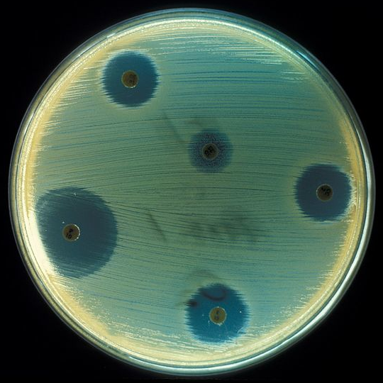
Antibiotics
Susceptible vs. Resistant
Antibiotic
Lawn
Clearing
Notes:
Susceptible: likely to be influenced by
Resistant: drug does not work on the bacteria (no longer kills it)
Image: http://en.wikipedia.org/wiki/File:Staphylococcus_aureus_(AB_Test).jpg

Slide 3
Antibiotics
Susceptible vs. Resistant
Lawn
The “lawn” is where bacterial growth is shown. The bacteria have been spread across the surface and allowed to grow
Notes:
Susceptible: likely to be influenced by
Resistant: drug does not work on the bacteria (no longer kills it)
Image: http://en.wikipedia.org/wiki/File:Staphylococcus_aureus_(AB_Test).jpg

Slide 4
Antibiotics
A larger clearing indicates that the antibiotic is more effective against the bacteria surrounding it. The larger the clearing, the more susceptible the bacteria are to that antibiotic
Susceptible vs. Resistant
Clearing
Notes:
Susceptible: likely to be influenced by
Resistant: drug does not work on the bacteria (no longer kills it)
Image: http://en.wikipedia.org/wiki/File:Staphylococcus_aureus_(AB_Test).jpg

Slide 5
Antibiotics
The smaller clearing shows evidence of resistance, or that the antibiotic may not be as effective against this type of bacteria
Susceptible vs. Resistant
Clearing
Notes:
Susceptible: likely to be influenced by
Resistant: drug does not work on the bacteria (no longer kills it)
Image: http://en.wikipedia.org/wiki/File:Staphylococcus_aureus_(AB_Test).jpg

Slide 6
Why do we care?
Antibiotic resistance leads to the development of superbugs
As these superbugs mutate to survive the antibiotic, the get stronger
If they get stronger, we are unable to treat those infections (aka people stay sick)

Slide 7
How do we stop it?
Several steps can be taken to slow antibiotic resistance
Not demanding antibiotics for viruses (antibiotics only treat bacterial infections)
Finishing the prescribed dose of antibiotics even if you feel better before they’re gone

Slide 8
Susceptible
+ Antibiotic
When people don’t finish the prescribed dose of antibiotics, the bacteria are able to learn what they’re up against and grow/mutate accordingly, making the antibiotics no longer effective in killing the bacteria.
Antibiotic Resistant

