Slide 1
2.01
Safety Considerations

Slide 2
Safety Considerations
Patient Safety
Healthcare Professional Safety
Environmental Safety

Slide 3
Safety Considerations
Patient Safety

Slide 4
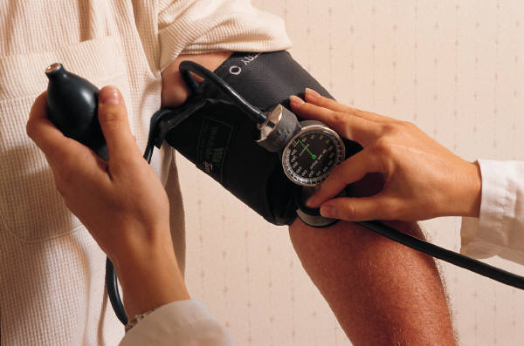
Patient Safety
Perform procedures for which you have been trained
2.01 Understand safety procedures

Slide 5
Patient Safety
Always identify the patient
2.01 Understand safety procedures

Slide 6
Patient Safety
Explain the procedures
2.01 Understand safety procedures

Slide 7
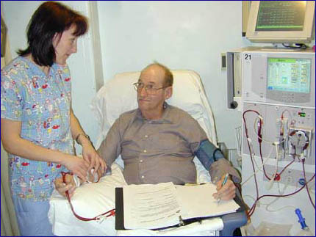
Patient Safety
Observe patient for response to treatment
2.01 Understand safety procedures

Slide 8
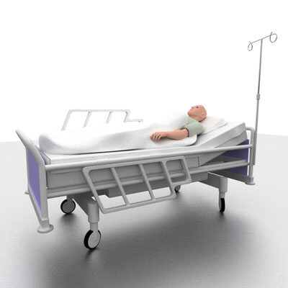
Patient Safety
Assure patient safety after procedures
position bed at lowest level
side rails up
wheels locked
place call bell within patient’s reach
2.01 Understand safety procedures

