Slide 1
Respiratory System:
Upper Airway
Health Science I
Cary High
Bechara

Slide 2
Objective: recall the structures of the upper respiratory system
  State the main role of the respiratory system
  List and describe the five functions of the upper airway
  Identify the structures of the upper airway
  Trace the flow of air through the upper airway structures
  Identify the upper airway diseases

Slide 3
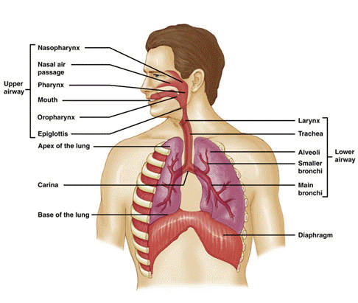
Respiratory System Overview
Upper airway:
    nose, pharynx, larynx, sinuses
Lower airway:
    Right lung
      Three lobes: Upper, middle, lower
    Left lung
      Two lobes: upper and lower
Diaphragm:
Primary muscle
Notes:
Air passes through the nares/ oral cavity and is conducted into the pharynx to the back of the mouth. It traverses through the oropharynx and is conducted across the vocal chords into the larynx. The epiglottis is a protective flap for the lung from foreign particle aspiration. Thereafter the air travels into the trachea into the main stem bronchus and into the bronchioles. The terminal bronchiole leads the air into the alveoli. The alveoli are the lung unit that interacts with the pulmonary capillary and takes place in gas exchange (external respiration).

Slide 4
Primary Roles of the Respiratory System
Ventilation (upper/lower airway):
  To conduct air in and out of the lungs
  Air consists of these gasses: Oxygen (O2), Carbon dioxide (CO2), and Nitrogen (N2)
Respiration External (lower airway and external atmosphere):
  Participate in gas exchange (O2 / CO2)
Notes:
Oxygen, Carbon dioxide and Nitrogen are the gasses present in the atmosphere. Nitrogen is inert and does not participate in gas exchange. O2 and CO2 also exchanged in cellular respiration (Internal Respiration). We will cover Internal Respiration in a future lesson.

Slide 5
Upper Respiratory System (guided practice for retention)
Please take out handout 2.05.
  refer to and label it during this lesson
  Take notes on the side or back
  Record the diseases that impact the upper airway (respiratory system) as they are discussed

Slide 6
Upper Airway functions:
Heat / cool inhaled air (to body temperature)
Filter particles from the inhaled gases
Humidify inspired gases to relative humidity of 100%
Provide for the sense of smell (olfaction)
Produce sounds (phonation)
Conduct air to the lower airways
Notes:
Body temperature is 37 degrees Centigrade or 98.6 degrees Fahrenheit. Humidification is critical especially during periods of exercise or in cold environments. Filtration is a function of the muco-ciliary escalator. Next slide discusses this in greater detail.

Slide 7
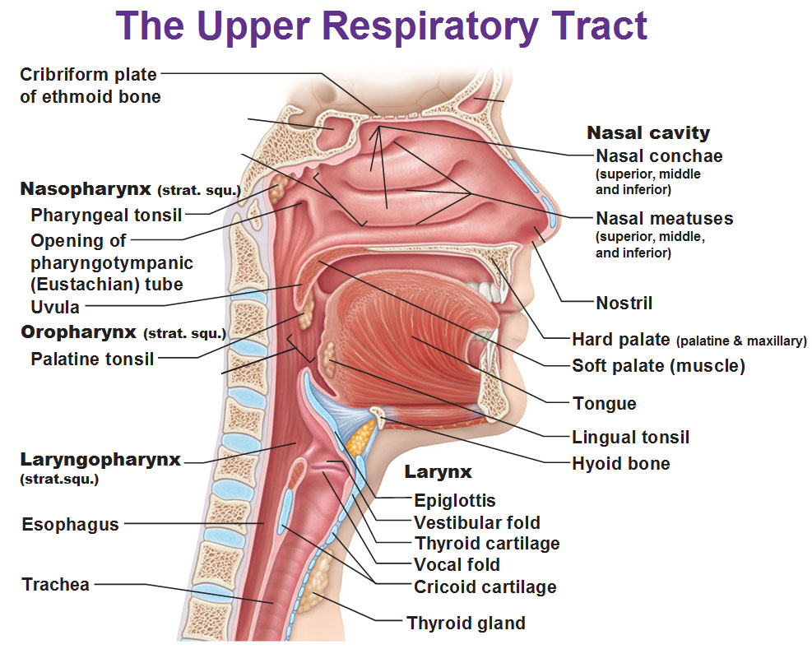
Upper airway structures
Notes:
Nasal cavity: Nares are also called nostrils. There are small hair-like structures called cilia in the nose. They serve to filter and moved foreign particles away from sterile lung field. The pharynx is a muscular structure that stems from the nasal cavity through the oral cavity. It is referred to as the throat. The epiglottis is a consists of cartilage that acts as a protective lid and covers the larynx during swallowing of food. This prevents aspiration of food into the lung.

Slide 8
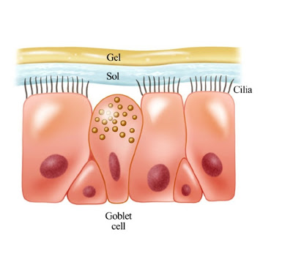
Mucocilliary escalator
Respiratory Mucosa contains the Mucociliary escalator:
  Respiratory mucosa: epithelial lining (nose – lower airway) has pseudostratified ciliated columnar epithelium.
  Each tall cell column has 200+ cilia its surface
  Goblet cells also present in the mucosa and produce mucus
  Cilia are in the sol layer –allows free movement
  Gel layer -sticky
Cell structure of the Mucociliary Escalator
Notes:
The epithelial lining is plays an important role in keeping the nose clean. Cells in this area (respiratory mucosa) are called pseudostratified ciliated columnar epithelium. These cells start in the nose and continue into the lower airways. The epithelial

Slide 9
How does the escalator work?
The cilia act like oars and continuously move (1,000 – 1,500 x minute)
Propels the gel layer and trapped debris upward toward the nose/mouth so that it can be expelled (sneezing, blowing nose or by coughing)
This functions 24 hours/day
Smoking inactivates this critical defense mechanism of the respiratory system!!

Slide 10
The sinuses are a part of the upper respiratory system.
What are sinuses?
Sinuses connect to the nasal cavity via small passageways (cavities)
They are located around the nose and are called “paranasal sinuses”
They are also lined with respiratory mucosa (produce mucus, humidify and warm the air)
They are named for the specific bones in which they are located

Slide 11
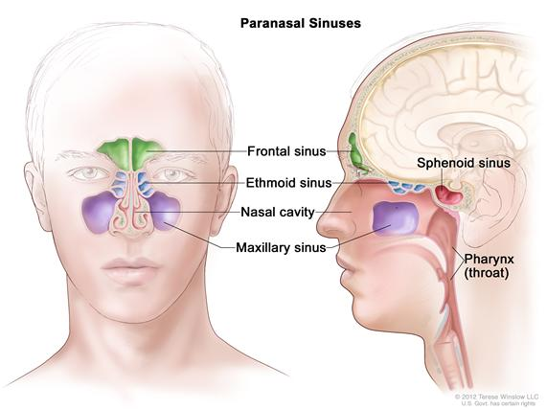
Notes:
Hand out Upper Respiratory System Handout. Have students color and label the sinus structures and the anatomical structures as instructed. Sinusitis is the inflammation of these sinuses. When there is excessive mucous in the sinus, it suggests a sinus infection.

Slide 12
Sinus related infections:
Acute rhinitis
Acute sinusitis
Chronic sinusitis
Notes:
Acute rhinitis (inflammation of the nasal passageways) can result due to allergen exposure or by a viruses (common cold). It can be associated with a secondary bacterial infection which can evolve into acute sinusitis. Sinusitis (inflammation of the sinuses) symptoms include facial pressure, pain and often a headache. In children, Otitis Media is subject to infections.

Slide 13
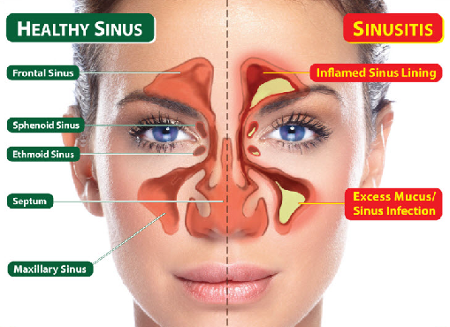
Sinusitis:
Notes:
This is a simplistic picture of sinus infection

Slide 14
Other upper airway diseases
Pharyngitis (sore throat)
  Strep Throat (bacterial infection of the throat)
Tonsillitis (swollen tonsils – difficulty swallowing)
Laryngitis (inflamed voice box)
Laryngotracheobronchitis (LTB=croup)can be viral or bacterial. Inspiratory noise (stridor)
Otitis Media (middle ear inflammation and/or infection) common in young children

Slide 15
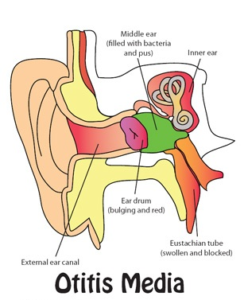
Otitis Media in children
Notes:
Middle ear infections usually in young children…frequently associated with fever.

Slide 16
More upper airway diseases
Acute epiglottis (caused by H. influenza B)
  Airway emergency for children 2-6 years old - results in high fever and noisy breathing
  4 D signs: distress, drooling, dysphagia and dysphonia.
Obstructive sleep apnea (breathing periodically stops during sleeps)
  caused by the soft tissues at the back of the throat closing off the airway
Asthma (upper/lower airway disease)
  Caused by inflamed and twitchy airways

Slide 17
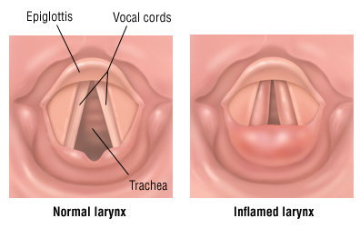
Laryngotracheobroncitis (LTB)
Notes:
Note the position of the epiglottis, the vocal cords and the larynx.

Slide 18
Lets assess your understanding...
Answer the following questions

Slide 19
1. Which gas is found in the atmosphere?
  Oxygen
  Carbon Dioxide
  Nitrogen
  All of the above
Notes:
Answer: d

Slide 20
Answer
all of the above gases are found in the atmosphere

Slide 21
2. The hollow muscular structure of the respiratory system commonly known as the throat is called:
Esophagus
Larynx
Pharynx
Trachea
Notes:
Answer: c

Slide 22
Answer
pharynx

Slide 23
3. The leaf-shaped, flap of cartilage lying behind the tongue and in front of the entrance to the larynx is the:
Epiglottis
Glottis
Valve
Vocal cords
Notes:
Answer: a

Slide 24
Answer
Epiglottis

Slide 25
4. The hair like structures that propel mucus in the airways are:
The sol layer
The gel layer
Cilia
pathogens
Notes:
Answer: c

Slide 26
Answer
c. Cilia

Slide 27
5. What pollutant inactivates the ciliary function?
Coal
Dust
Smoke
Air deodorizers

Slide 28
Answer
Smoke

Slide 29
6. Select the proper sequence of air traveling through upper airway:
Nose, sinuses, lungs, vocal cords
Nose, pharynx, larynx, vocal cords, lungs
Nose, larynx, vocal cords, pharynx, lungs
Nose lungs, sinuses, pharynx, vocal cords
Notes:
Answer: b

Slide 30
Answer
Nose, pharynx, larynx, vocal cords, lungs

Slide 31
7. Upper airway diseases health problems include:
Sinusitis
LTB (croup)
Tonsillitis
Rhinitis

Slide 32
Answer
All answers are correct:
sinusitis, laryngotracheobronchitis, tonsillitis and rhinitis are all health problems of the upper airway.

Slide 33
Well Done!!
Homework reinforcement time
Follow the instructions to color the Upper Respiratory System Structures that you just labelled during class - handout 2.05.
Review your notes from today and highlight the following terms and their descriptions: muco-ciliary escalator, olfaction, and phonation, LTB, acute epiglottitis, and otitis media.
    Then write them down on a separate sheet of paper in complete sentences (to be handed in).
Give three real life examples that illustrate how air is heated, cooled, and humidified by the upper airway system. There should be three different examples on paper (in complete sentences).
Due at start of class tomorrow!

