Slide 1
2.01
Safety Considerations

Slide 2
Safety Considerations
Patient Safety
Healthcare Professional Safety
Environmental Safety

Slide 3
Safety Considerations
Patient Safety

Slide 4
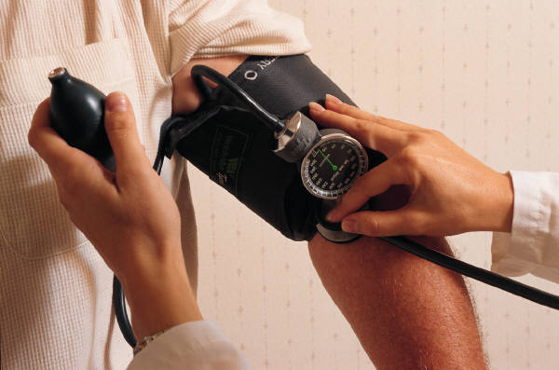
Patient Safety
Perform procedures for which you have been trained
2.01 Understand safety procedures

Slide 5

Patient Safety
Always identify the patient
2.01 Understand safety procedures

Slide 6

Patient Safety
Explain the procedures
2.01 Understand safety procedures

Slide 7

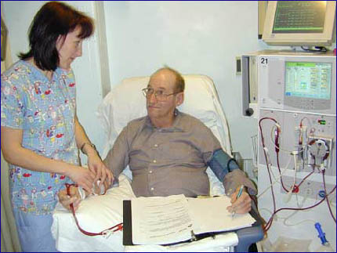
Patient Safety
Observe patient for response to treatment
2.01 Understand safety procedures

Slide 8


Patient Safety
Assure patient safety after procedures
  position bed at lowest level
  side rails up
  wheels locked
  place call bell within patient’s reach
2.01 Understand safety procedures

Slide 9
Healthcare
Professional
Safety

Slide 10


Healthcare Professional Safety
Walk, don’t run
2.01 Understand safety procedures

Slide 11
Healthcare Professional Safety
Report injury, accident or
unsafe situation
2.01 Understand safety procedures

Slide 12

Healthcare Professional Safety
Wash hands frequently
2.01 Understand safety procedures

Slide 13

Healthcare Professional Safety
Wear safety glasses when risk of eye injury
2.01 Understand safety procedures

Slide 14

Healthcare Professional Safety
Avoid “horseplay”
2.01 Understand safety procedures

Slide 15

Healthcare Professional Safety
Always follow instructions carefully
2.01 Understand safety procedures

Slide 16
Healthcare Professional Safety
Use correct posture and body mechanics
The efficient movement and balance of the body
2.01 Understand safety procedures

Slide 17
Healthcare Professional Safety
Walk, don’t run
Report injury, accident, or unsafe situation
Wash hands frequently
Wear safety glasses when risk of eye injury
Avoid “horseplay”
Always follow directions
Use correct posture and body mechanics
2.01 Understand safety procedures

Slide 18

Healthcare Professional Safety
Ergonomics
The study of workplace design and equipment used by employees that contribute to the
comfort
efficiency
safety
ease of use
2.01 Understand safety procedures

Slide 19
Healthcare Professional Safety Ergonomic Program
Personal components include
  Comfort
  Good posture
  Exercise to prevent stiffness and soreness
  Body mechanics
2.01 Understand safety procedures

Slide 20
Healthcare Professional Safety
Ergonomic Program
Workplace design includes
Comfort
Placement of furniture for ease of work
Avoidance of repetitive motions
Awareness of hazards in the environment
2.01 Understand safety procedures

Slide 21
Environmental
Safety

Slide 22
Environmental Safety
For this unit, Environmental Safety refers to the healthcare setting (patient areas, waiting rooms, workspaces, etc.)

Slide 23

Environmental Safety
General Guidelines
Read Policy and Procedure Manual
2.01 Understand safety procedures

Slide 24
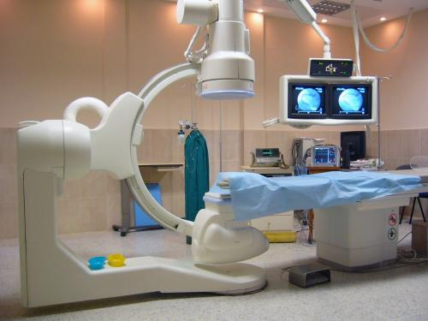
Environmental Safety
General Guidelines
Always get training before operating equipment
2.01 Understand safety procedures

Slide 25


Environmental Safety
General Guidelines
Use electrical equipment in a dry area, free from water
2.01 Understand safety procedures

Slide 26



Environmental Safety
General Guidelines
Observe all safety precautions
2.01 Understand safety procedures

Slide 27
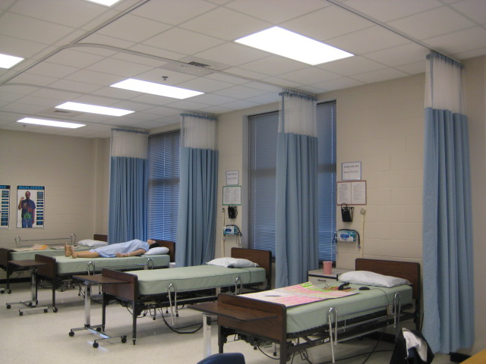
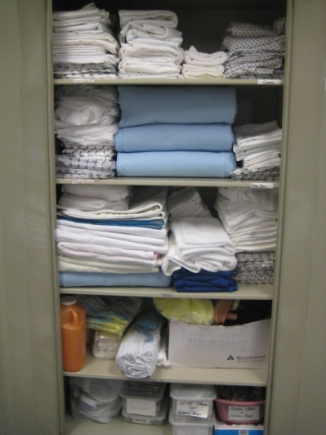
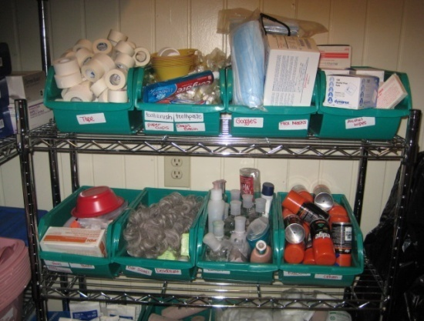
Environmental Safety
General Guidelines
Keep area clean and neat
2.01 Understand safety procedures
Notes:
Louisburg
Overhills
Hobbton

Slide 28
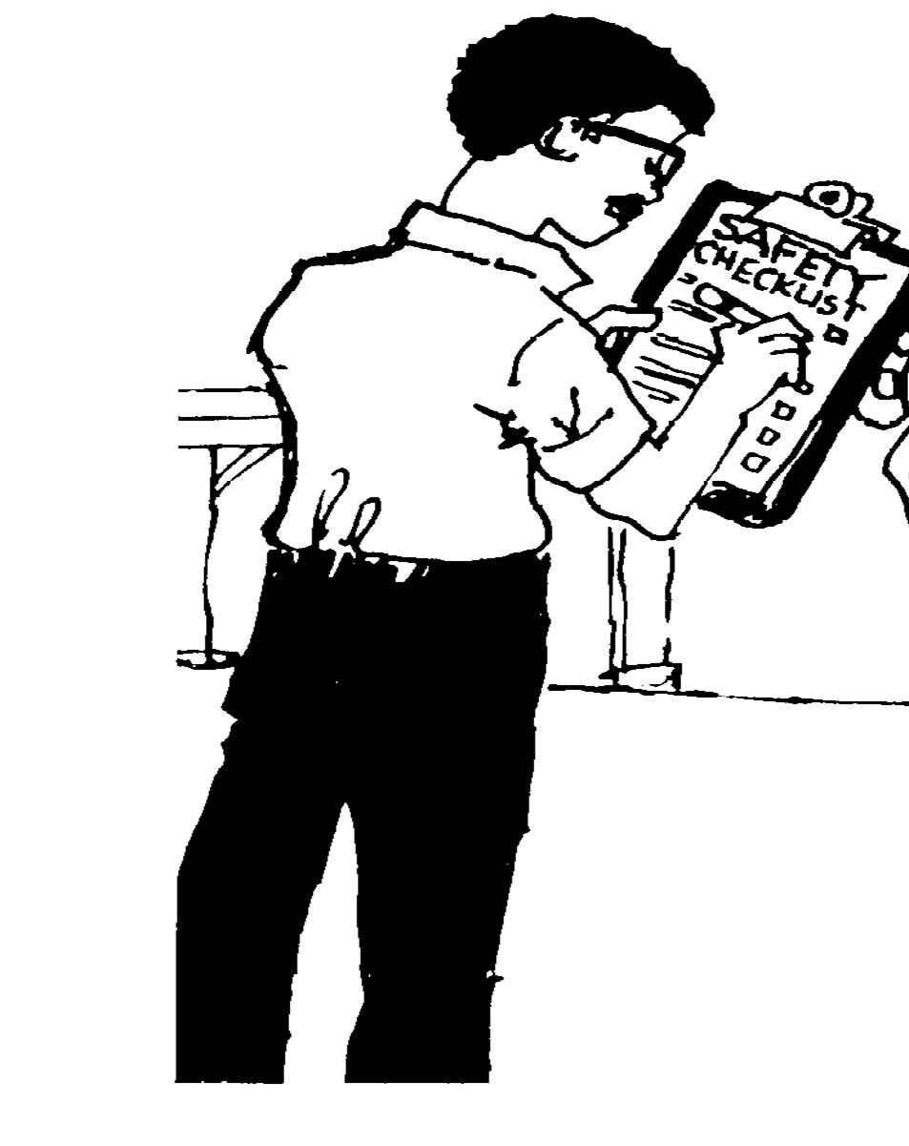
Environmental Safety
General Guidelines
Frequently check for safety hazards in patient and visitor areas
2.01 Understand safety procedures

Slide 29

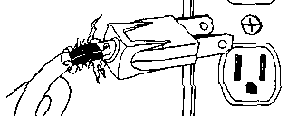
Environmental Safety
General Guidelines
Report unsafe situations
2.01 Understand safety procedures

Slide 30
Environmental Safety
Hazardous Materials
2.01 Understand safety procedures

Slide 31

Environmental Safety
Hazardous Materials
Employer must inform employee of chemicals or other hazards in the workplace
2.01 Understand safety procedures

Slide 32
Environmental Safety
Hazardous Materials
Handling Liquids
  Read label at least 3 times
  Never mix solutions
  Store solutions in a
  locked cabinet
2.01 Understand safety procedures

Slide 33
Environmental Safety
Hazardous Materials
Safety Signs and Symbols
2.01 Understand safety procedures

Slide 34

Environmental Safety
Hazardous Materials
Safety Signs and Symbols
Materials marked with this symbol may be contaminated or contain infectious pathogens
2.01 Understand safety procedures

Slide 35

Environmental Safety
Hazardous Materials
Safety Signs and Symbols
This sign is found near radiation treatment areas or x-ray facilities
2.01 Understand safety procedures

Slide 36

Environmental Safety
Hazardous Materials
Safety Signs and Symbols
This sign is used on damaged or dangerous equipment
2.01 Understand safety procedures

Slide 37

Environmental Safety
Hazardous Materials
Safety Signs and Symbols
Sign indicates area in which compressed oxygen is being used. No smoking or open flames should be present in these areas.
2.01 Understand safety procedures

Slide 38

Environmental Safety
Hazardous Materials
Safety Signs and Symbols
This sign indicates which type of personal protective equipment must be worn before entering a specific area. Can also indicate specific safety hazards
2.01 Understand safety procedures

Slide 39

Environmental Safety
Hazardous Materials
Safety Signs and Symbols
Sign placed in areas that are highly contaminated and should only be entered by trained individuals who are wearing the proper protective equipment
2.01 Understand safety procedures

Slide 40

Environmental Safety
Hazardous Materials
Material Safety Data Sheets
Required by Occupational Safety and Health Administration (OSHA)
Must have a Material Safety Data Sheet (MSDS) for every liquid in the facility
2.01 Understand safety procedures

Slide 41
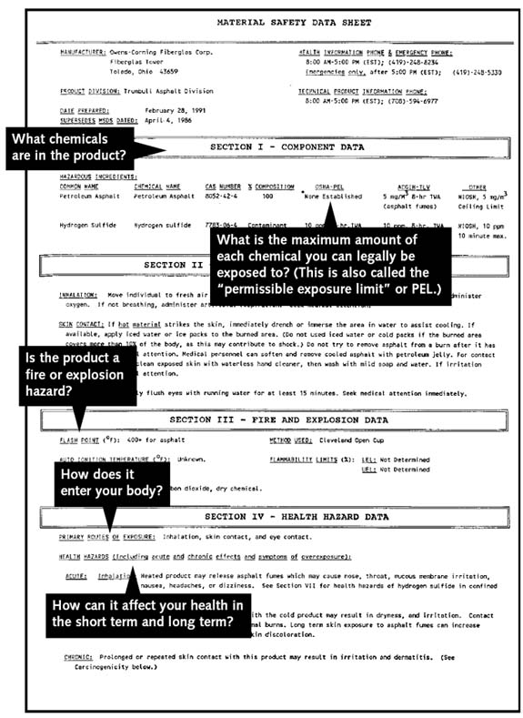
Environmental Safety
Hazardous Materials
Material Safety Data Sheets
Product Information
Precautions
Instructions for use
Clean up procedure
Disposal
Emergency Care if injured
2.01 Understand safety procedures

