Slide 1
3.05 Remember the structures of the Integumentary System

Slide 2
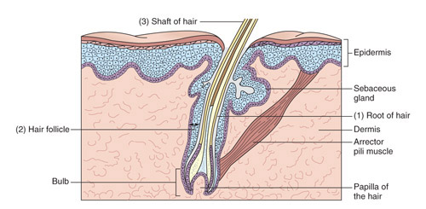
Essential Questions
What are the structures of the
integumentary system?

Slide 3
Structures of the integumentary system
Layers of the integumentary system
Epidermis
Dermis
Subcutaneous
About the size of a shower curtain in an adult.

Slide 4
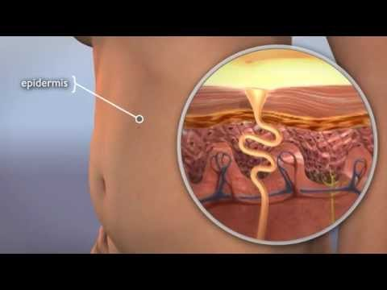
Structures of the integumentary system
Epidermis
Outermost covering
Made of epithelial cells
Avascular

Slide 5
Structures of the integumentary system
Dermis
True skin
Made of connective tissue
Vascular

Slide 6
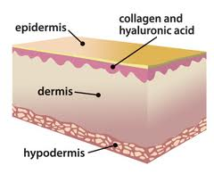
Structures of the integumentary system
Dermis contains many structures (organs)
Connective tissue
Collagen tissue bands
Elastic fibers
Numerous blood vessels
Nerve endings
Muscles
Hair follicles
Oil glands
Sweat glands
Fat cells
subcutaneous

Slide 7
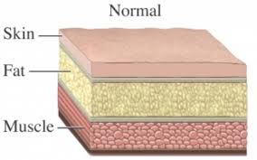
Structures of the integumentary system
Subcutaneous layer
Hypodermal
Lies under the dermis
Sometimes called superficial fascia
Consists of loose connective tissue
Contains one-half of the body’s stored adipose tissue
epidermis,
dermis
subcutaneous

Slide 8
Structures of the integumentary system
With age, the subcutaneous layer begins to disappear; this causes the skin to sag and wrinkle.
epidermis,
dermis
subcutaneous

Slide 9
Structures of the integumentary system
Appendages
Hair
Nails
Glands
Sweat glands
Sebaceous glands
epidermis,
dermis
subcutaneous

Slide 10
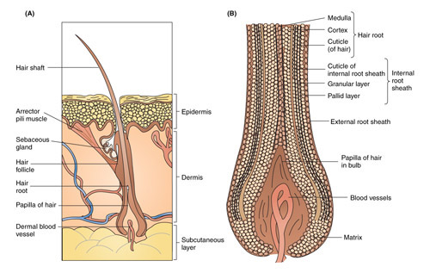
Structures of the integumentary system
Hair
Cortex and medulla
Root and shaft
Hair follicle
Papilla
Arrector pili muscle
Beards are the fastest growing hairs.
Nearly 30 feet in a lifetime!

Slide 11
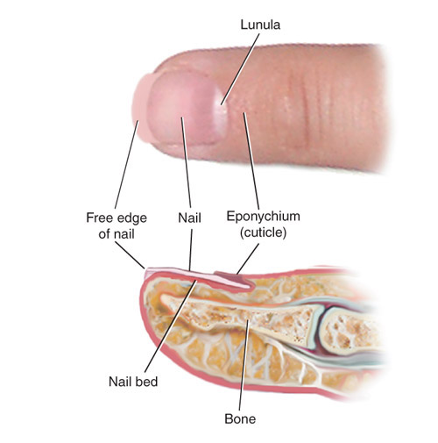
Structures of the integumentary system
Nails
Made of keratin
Originate from the nail root
Did you know????
In Egypt, the status of women were established by the color of their nail… red being the highest.

Slide 12
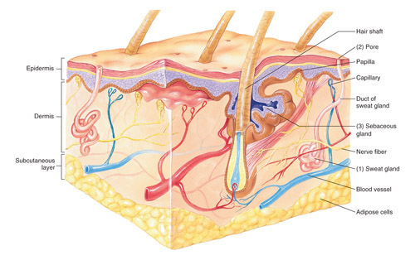
Structures of the integumentary system
Sudoriferous glands
Sweat glands
Present in large numbers under arms, palms of hands, and soles of feet

Slide 13
Structures of the integumentary system
Sebaceous glands
microscopic glands
located adjacent to a hair follicle

Slide 14
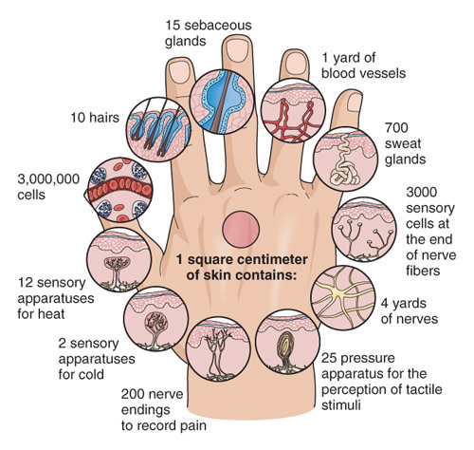
Structures of the integumentary system
Microscopic view
of the skin

Slide 15
Essential Questions
What are the structures of the
integumentary system?

