Slide 1
4.01 Remember the structures of the urinary system

Slide 2
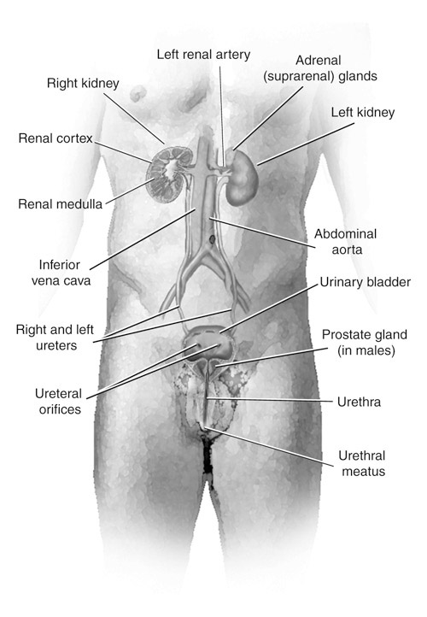
4.01 Remember the structures of the urinary system Essential Question
What are the structures of the urinary system?

Slide 3
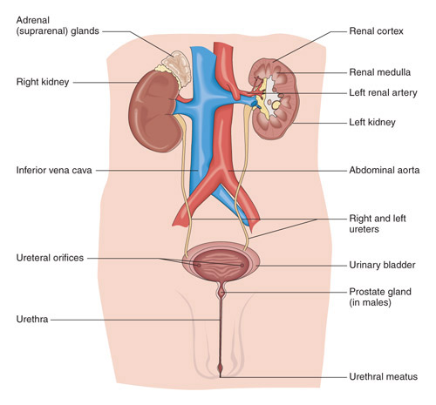
Structures of the urinary system
Kidneys
Ureters
Bladder
Urethra
Urinary meatus

Slide 4
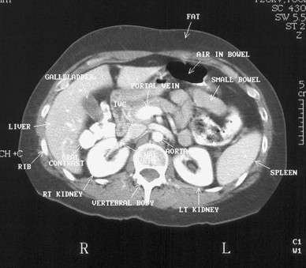
Structures of the urinary system
Kidneys
Most important excretory organ
Bean-shaped
Located between peritoneum and the back muscles (retroperitoneal)
Held in position by connective tissue
Enclosed in an adipose capsule
Protected by the ribs

Slide 5
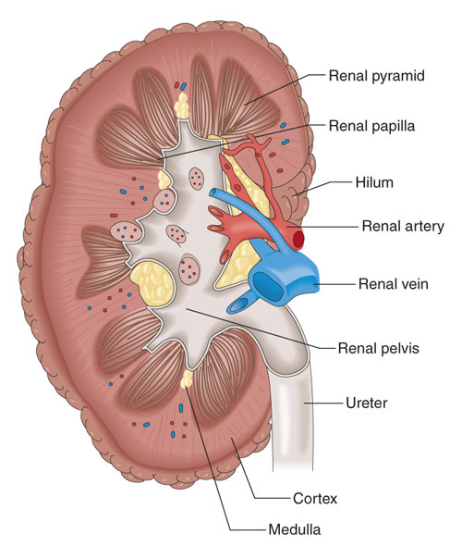
Structures of the urinary system
Kidneys
External structures
Renal capsule
Renal hilum
Internal structures
Renal cortex
Renal medulla
Renal pelvis

Slide 6
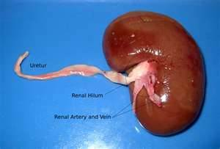
Structures of the urinary system
External kidney
Renal fascia
Fibrous layer of connective tissue
Renal hilum
Indentation that gives the kidney its bean-shaped appearance

Slide 7
Structures of the urinary system
Internal kidney
Renal cortex
Outer layer
Renal medulla
Middle layer
Renal pelvis
Innermost layer

Slide 8
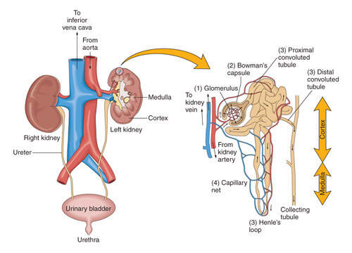
Structures of the urinary system
Renal cortex
Composed of millions of microscopic functional units called nephrons

Slide 9
Structures of the urinary system
Nephron
Functional unit of kidney
Renal corpuscle
Bowman’s capsule
Glomerulus
Renal tubule
Proximal convoluted tubule
Loop of Henle
Distal convoluted tubule
Collecting tubules
Each kidney contains about
1.3 MILLION nephrons!

Slide 10
Structures of the Urinary system
Renal medulla
Inner, striated layer
RENAL PYRAMIDS are the striated cones.
Base of each pyramid faces cortex, while apex empties into cuplike cavities called CALYCES
Renal columns
Located between the pyramids
Cortical tissue

Slide 11
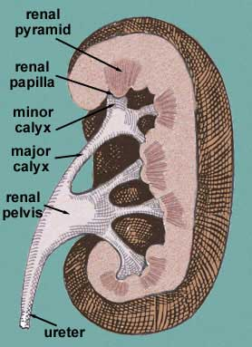
Structures of the urinary system
Renal pelvis
Funnel shaped structure at the beginning of the ureter

Slide 12
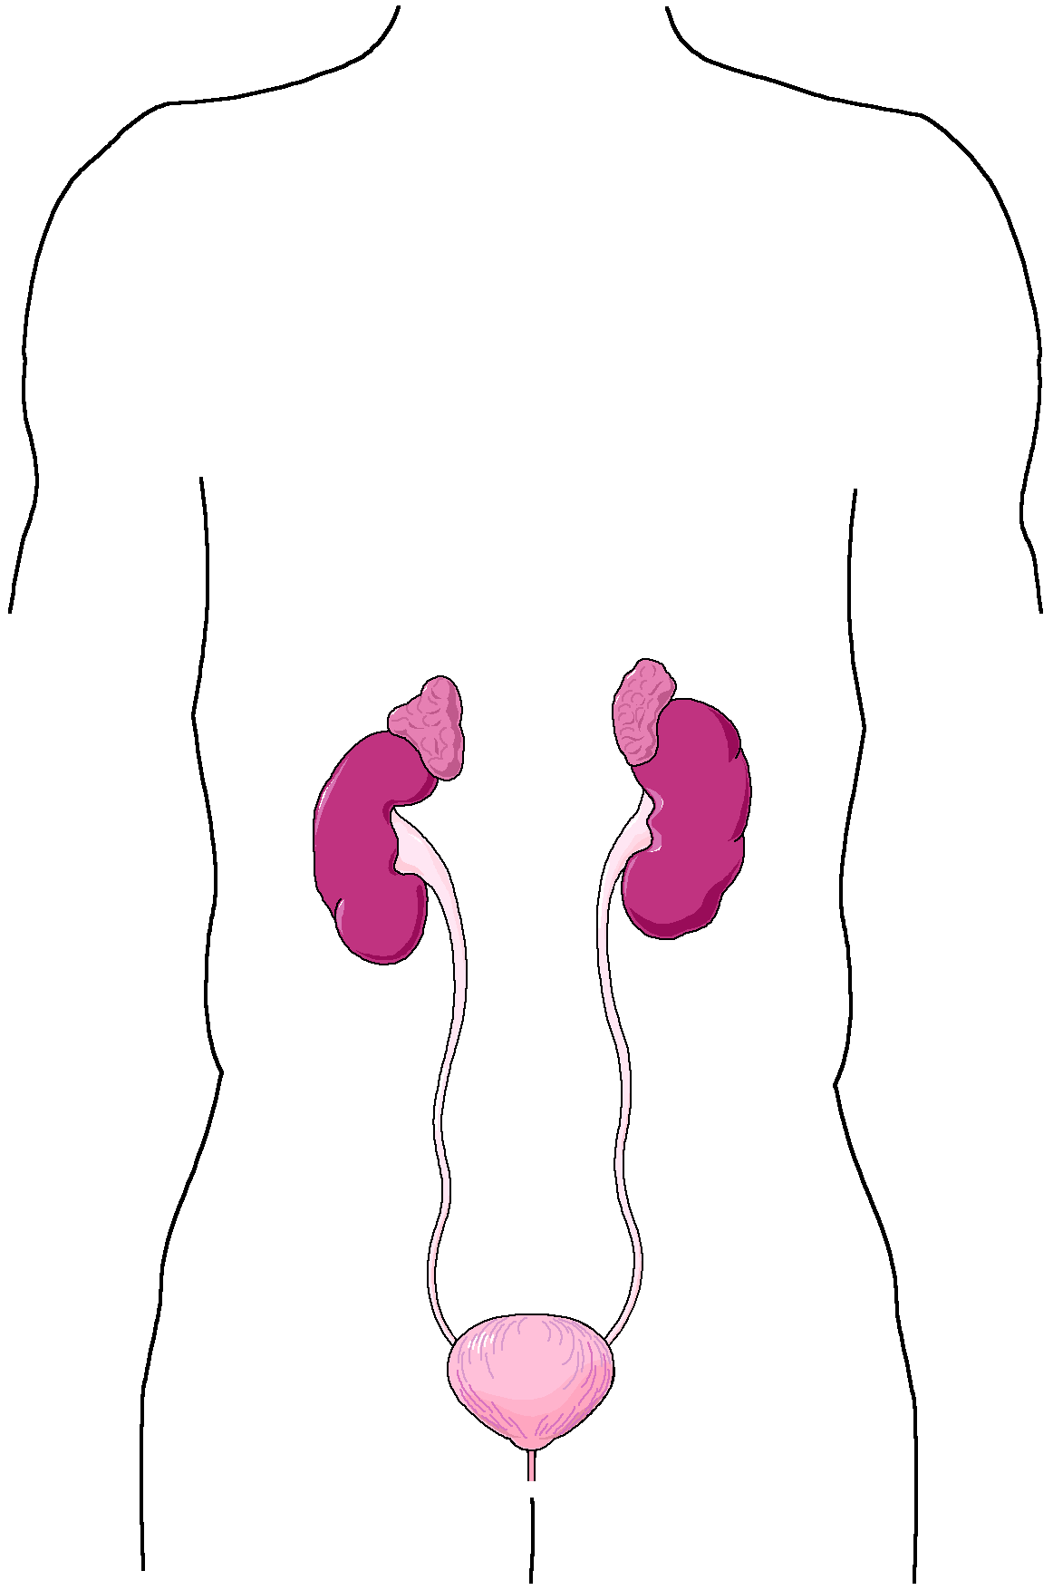
Structures of the urinary system
Ureters
Muscular tube extending from each kidney to the urinary bladder
Lined by a mucous membrane
10-12” long
Ureters

Slide 13
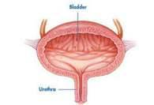
Structures of the urinary system
Urinary bladder
Hollow muscular organ
Located in pelvic cavity
Made of elastic fibers and involuntary muscles

Slide 14
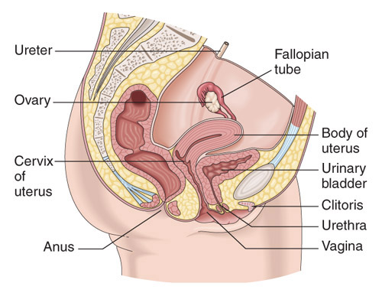
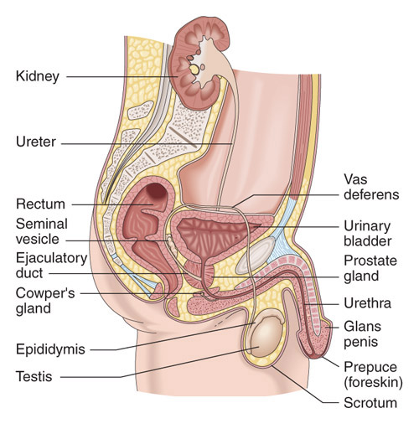
Structures of the urinary system
Female
Urethra
Connects the bladder to the outside of the body
Female 1-2” long
Male 4-6” long
Urinary meatus
Opening to the outside of the body
Male

Slide 15
4.01 Remember the structures of the urinary system Essential Question
What are the structures of the urinary system?

