Slide 1
Regenerative Medicine
Tissue engineering for replacing, regenerating or restoring human cells, tissues and organs to normal function. It may involve the use of stem cells, biomaterials, and/or patient’s own cells.

Slide 2
Lesson Objectives
Define basic terms associated with regenerative medicine.
Explain the rationale for pursuing regenerative medicine at a public policy level.
Understand the application of DNA technology (cloning, Genetically Modified Organisms, stem cells research and Human Genome Project)

Slide 3
Regenerative Terms
Cell: basic unit of structure and function of all living things. Cell biology is the study of cells.
Tissue: a group of similar cells from the same origin performing a specific function (smooth muscle tissue, connective tissue)
Organs: combine two or more tissues that function together (heart, kidney, stomach)
Scaffold: biomaterial that supports the structure for cells to grow and orient themselves when building replacement tissues and organs

Slide 4
More terms…
Extracellular matrix: surrounds and supports the cells that form tissues and organs in the body. It is created and maintained by cells.
Decellularization: is the process of removing cells from the extracellular matrix.
Biomaterials: are synthetic or natural biocompatible materials used to replace part of a living system or function in intimate contact with living tissue.

Slide 5
Terms – Stem cells
Undifferntiated Stem cells: cells that give rise to other cells.
Totipotent: stem cells that can give rise ALL other tissues needed by the body as well as the extra embryonic tissues (ie: placenta)
Pluripotent: stem cells that can give rise to all the other types of body cells.
Differentiated Stem cells:
Multipotent: adult stem cells. They can give rise to like body cells.

Slide 6
Human Genome project: designed to generate a resource that could be used for a broad range of biomedical studies; the genetic variations that increase risk of specific diseases, such as cancer, or to look for the type of genetic mutations. More research can now be done to fully understand how the genome functions and to discover the genetic basis for health and disease.
Epigenetics: the study of heritable changes in gene expression that are not caused by changes in the DNA sequence.

Slide 7
Physiology: the study of the functions of living organisms and their parts
Pathology: the study of disease
Pharmacology: the study of the drug action and its effect on the cell, tissue organ and organism
Toxicology: study of adverse effects of chemicals on living organisms

Slide 8
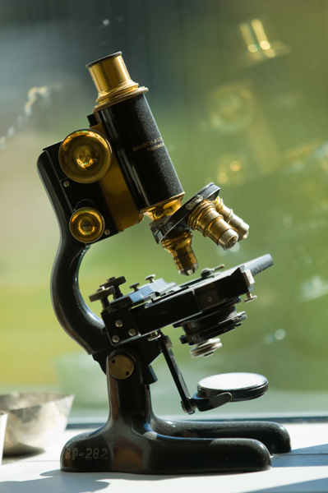
Microbiology: study of
microscopic organisms
Molecular biology: study of the molecular basis of biological activity
Immunology: study of all aspects of the immune system in all organisms
Genetics: study of genes, heredity, and variation in living organisms

Slide 9
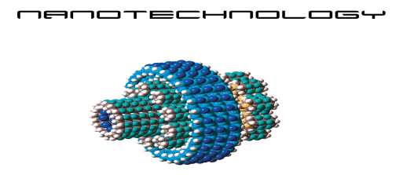
Nanotechnology: creating and manipulating materials on an atomic, molecular and supramolecular scale
Biotechnology: the use of living organisms or other biological systems to manufacture drugs or other products (for environmental management, as in waste recycling): includes the use of bioreactors in manufacturing, microorganisms to degrade oil slicks or organic waste, genetically engineered bacteria to produce human hormones, and monoclonal antibodies to identify antigens.

Slide 10
Why regenerative medicine? Story of Luke
Luke needed a new bladder. He had a paralyzed bladder due to spina bifida.
He was on dialysis.
Dr. Atala (WF institute for regenerative medicine) created a healthy bladder for him using his own cells and a scaffolding technology.
https://www.youtube.com/watch?v=9RMx31GnNXY
Luke graduated high school, was on the wrestling team and is in college.

Slide 11
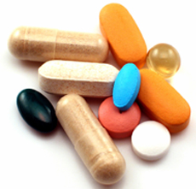
Is there a need for research in regenerative medicine?
There is a notable shortage of organ donation
Many on the kidney transplant list do not survive to the transplant
Those that do get organ transplants are on anti-rejection medications the remainder of their lives so that they will not reject the donated organs.

Slide 12
Currently there has been some success in regenerating “flat organs” (bladders, ureters, blood vessels.
Complex “solid organs” are more challenging because they have many specialized parts (ie: kidneys have filters, blood vessels, etc)

Slide 13
How is a scaffold made?
The extracellular matrix is consists of proteins and polysaccharides. These are linked to proteins to form a gel substance in which other fibrous proteins are embedded.
This gel allows diffusion of nutrients, wastes and other chemicals to and from the cells. . . Thus decellularizing the tissue or organ. This is what forms the scaffold for the new organ.

Slide 14
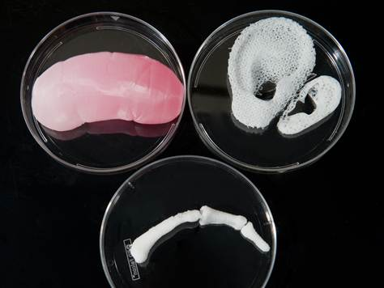
Scaffolds of organs

Slide 15
Challenges to scaffold generation
The biomaterials used for scaffolds must be nonreactive with the human immune system.
They materials need to be strong enough to last until the new organ creates its own extracellular matrix and then dissolve away like surgical structures.
Once the biomaterials are developed, the challenge is to create the scaffold.

Slide 16
More challenges
Bioprinters holds hope but is still experimental.
Decellularization poses issues when attempting to remove the cells without damaging the function of the scaffold.
Researchers are experimenting with various detergents and enzymes as well as different protocols to perfuse the tissue and remove the cells safely.
Growing the cells on the scaffolding outside the body is a problem. Many cells prefer the right environment for regeneration.

Slide 17
Challenges / hope
Stem cells are needed for cells to populate the extracellular matrix.
Totipotent and pluripotent are extremely versatile.
Amniotic fluid offers great hope because it is acquired at birth, does not require destroying embryos, and are considered multipotent and can be used for many different type of cells.

Slide 18
Let’s review
Why is regenerative medicine being pursued from a research end?
What is the extracellular matrix?
What is a tissue scaffold?
What is decellularization? Why is it important?
Which stem cells are hold the greatest versatility?
Notes:
1. Regenerative medicine is being pursued due to the limited number of organ donors, a significant need, and the life long immunosuppressant meds required for recipients. 2. extracellular matrix surrounds and supports the cells that form tissues and organs in the body. It is created and maintained by cells. 3. biomaterial that supports the structure for cells to grow and orient themselves when building replacement tissues and organs 4. decellularization is the process of removing cells from the extracellular matrix. 5. the study of heritable changes in gene expression that are not caused by changes in the DNA sequence

