Slide 1
Benefits of Biomedical Research
BMT
Cary High

Slide 2
Objective:
Understand the benefits of biomedical research
Essential questions:
Where would I see evidence of Biomedical research in my daily activities?
How do biomedical advances improve the health of the public?
How do biomedical advances improve animal health?

Slide 3
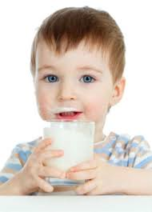
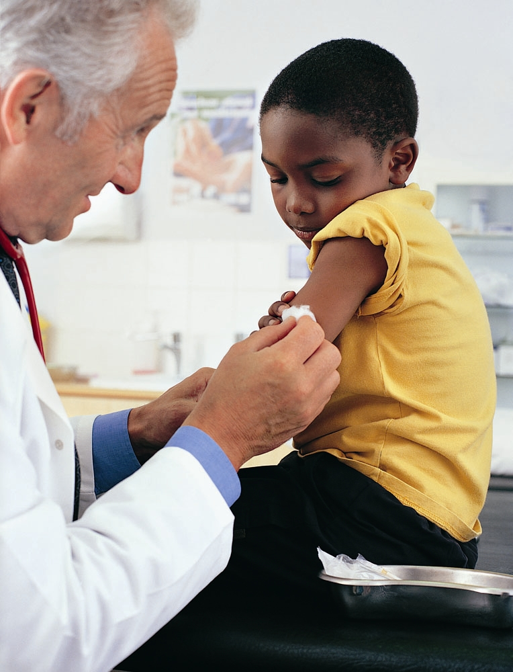
Did you ever:
Drink milk?
Receive a vaccine?

Slide 4
Milk
Is fortified with Vitamin D
Needed for proper absorption of Calcium which is needed for bone growth

Slide 5
vaccines
NC requires children to be vaccinated for against several diseases before starting school
Polio
Diphtheria (whooping cough)
Tetanus
Pertussis
MMR
H-influenza type B
Hep B
Chicken pox

Slide 6
Did you ever?
Take an antibiotic or an ear infection or strep throat?
Observe an endangered species at the zoo?

Slide 7
Antibiotics
Penicillin
Alexander Fleming, a biomedical researcher discovered this potent antibacterial agent

Slide 8
Endangered species
Biomedical technology uses embryo transfer
To increase the population of endangered species

Slide 9
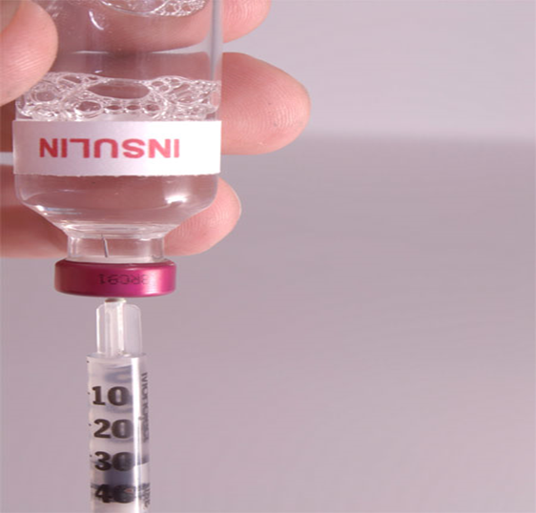
Did you ever?
Know anyone with Diabetes?
Is he taking insulin or other medication for his condition?

Slide 10
There isn’t a day that goes by that medical research doesn’t affect our lives
BM research on cigarette smoking has resulted in a 40% decrease in the number of deaths from heart disease.
We now have non-smoking facilities as a result of Biomedical research.

Slide 11
Vaccines save millions of lives
Mumps
Measles
Rubella
Chicken pox
Polio
etc

Slide 12
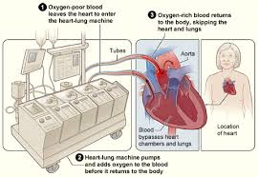
Biomedical research advanced treatment for:
Heart Disease: development of the heart lung machine in the 1950’s. This made heart surgery possible. 600,000 cardiac bypass operations occur annually in the US.

Slide 13
Diabetes
Inability of the body to produce sufficient insulin needed to regulate the use of carbohydrates and fats. Affects 26 million Americans.
BM research discovered that the pancreas of cows and pigs could be a source of insulin for humans.
Biomedical advances in the treatment have made it available in vitro. More readily available and less expensive.
Sugar monitors require less blood and less pain to acquire it.

Slide 14
Cancer
Gene therapies deliver instructions in the form of DNA sequences to diseased cells telling them to produce therapeutic proteins… turning off the cancer producing gene.

Slide 15
Leukemia
Childhood cancer that results in death.
Treatment: requires bone marrow transplant by a matched donor (usually family member).
BM research discovered a procedure that removes the bone marrow, destroys the leukemia and returns the marrow to the patient.
30000-40000 bone marrow transplants are performed each year.

Slide 16
Early vaccines
Prior to early vaccines, the life expectancy was 31 years old.
Small pox, cholera and typhoid fever were commonplace.

Slide 17
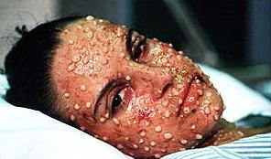
Edward Jenner
Developed a vaccine against small pox. Prior to that 1/10 children under 4 years old died of small pox.
World Health Organization launched global campaign about small pox in 1967 which has led to its eradication.

Slide 18
Louis Pastuer
In the 19th century, developed vaccines for:
Cholera
Rabies
Anthrax

Slide 19
Jonas Salk – Polio vaccine
Up until the development of the vaccine in the 1950s, poliomylelitis was dreaded disease.
Salk identified three strains of polio and created a vaccine that was 99% effective against two of the strains.

Slide 20
Albert Sabin – oral polio vaccine
Advanced the polio vaccine process by making it orally available from an ATTENUATED dose of the virus.
Once the virus was introduced in the body, it would stimulate the immune response

Slide 21
Chicken Pox
Varicella common and contagious disease
Can cause serious problems in adults
Vaccine became available in 1995, cases of chicken pox have dramatically decreased.

Slide 22
Hepatitis (A and B)
Causes serious liver problems.
Hepatitis B vaccine became available in 1989 and is now given to infants
Hepatitis A vaccine (available since 1995) is given to people travelling to under developed countries.

Slide 23
Fluoride
Scientists noticed that there was less tooth decay and stronger teeth in areas where small amounts of fluoride was naturally occurring in the water. Now it is routinely added to water supply in US cities.

Slide 24
Alexander Fleming
Discovered penicillin.
Very few side effects. Remains one of the safest antibiotics available.
However due to widespread resistance, its value is diminished some.

Slide 25
Cyclosporine/anti-rejection drugs.
Primary failure of organ transplantation is rejection of the organ by the patient’s own immune system.
Cyclosporine suppresses the immune system enough to accept the transplant. Numerous other anti-rejection drugs have become available.

Slide 26
Monoclonal antibodies
Antibodies produced by B lymphocytes produce a defense against infection.
Monoclonal antibodies involve the cloning of a single B lymphocyte so that uniform antibodies can be made in large quantities (from a single ancestor cell).
They can target specific tumor cells
They have been helpful in AIDS treatment.

Slide 27
Pacemakers
Used for treating erratic heart rhythms. They are programmable therefore they can be customized to meet the specific needs of the patient.

Slide 28
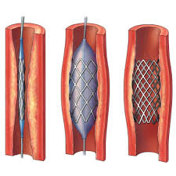
Angioplasty
Cardiology treatment that is invasive and life-saving
It can mitigate the need for open heart surgery.

Slide 29
Organ Transplantation
Heart transplants (first done in 1967 by Dr. Barnard). 2000 transplants / year today.
Kidney transplant (first done by Dr. Murray in 1954)
16000 kidney transplants today
Anti-rejection meds and dialysis make this possible.
Liver transplants (first done by Dr. Russell in 1963). 6000 liver transplants/ year today.

Slide 30
Tissue transplants
Tissues such as glands, blood vessels, muscles, nerves and bone marrow.
Corneas-very low rejection rate due to the fact that it has no connection with the blood supply. CORNEAS are the most commonly transplanted tissue todyay!

Slide 31
Biomedical advances in animal treatment and health
Joints
Cancer treatment
Gum treatment
Feline leukemia
Vaccines
Antibiotics
Anesthesia
Heartworm prevention
Allergies
Anemia
Heart disease
Kidney disease
Lyme disease
Rabies
Worms
distemper

Slide 32
Other advancements for animals
Artificial hips/joints for pet injuries
Surgery and microsurgery for organ transplants
Drugs and vaccines to treat diseases early, keeping our consumed food free from infection.

Slide 33
Vaccines for animals
Dogs:
Rabies
Distemper
Parvovirus
Hepatitis
Leptspirosis
Cattle:
Leptospirosis
brucellosis
Cats:
Feline leukemia
rabies
Feline enteritis
Rhinotracheitis
Pneumonitis
Sheep:
Anthrax and bluetongue

Slide 34
Wildlife endangered
Biomedical research has utilized in vitro fertilization to help re-populate the endangered species.

Slide 35
Upcoming test
Study your handouts, written notes on scientist presentations, bellwork, and feel free to review the power points on BB:
BM research types
BM methods
BM advances
BM Scientists

