Slide 1
Biomedical Research
Exploring types of biomedical research

Slide 2
Lesson objectives
Describe SCIENCE and scientific method
Define biomedical research (BM)
Describe the three types of BM research
Recall at least six Biotech companies in NC
Student activity:
Explore early super scientists

Slide 3
What is Science?
WHAT is SCIENCE?
It is KNOWLEDGE!
It is observing, studying and experimenting to learn how the world works
It is always evolving
It seeks predictability
It uses the scientific method in discovery

Slide 4
What is a biomedical research?
Is the study of medicine devoted to life processes; the prevention and treatment of disease; and the genetic, lifestyle and environmental factors related to disease and health.
Can you think of any current events that involved biomedical researchers?

Slide 5
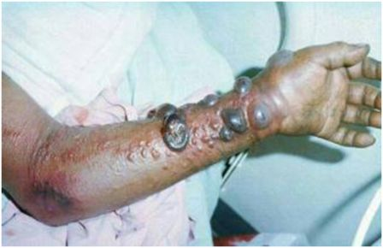
EBOLA virus: 2 US citizens July 2014

Slide 6
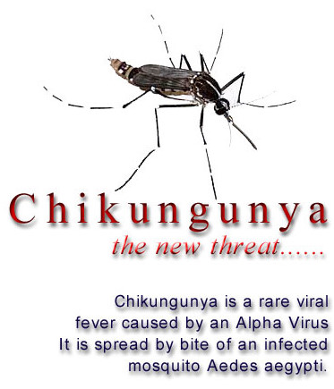
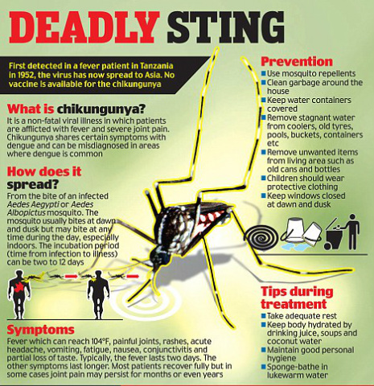
Chikungunya in US July 2014

Slide 7
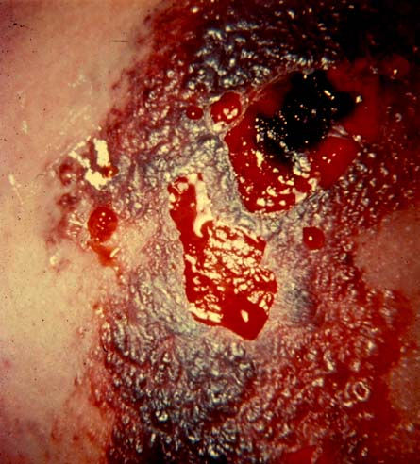
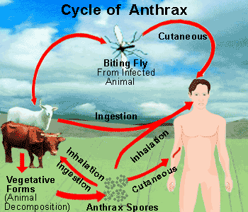
Anthrax scare CDC June 2014
http://www.beltina.org/health-dictionary/anthrax-disease-symptoms-treatment.html
Notes:
Serious public health concerns were discussed about this mishap: http://www.cnn.com/2014/06/19/health/cdc-possible-anthrax-exposure/index.html

Slide 8
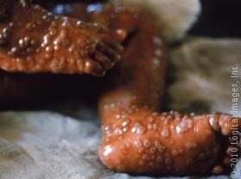
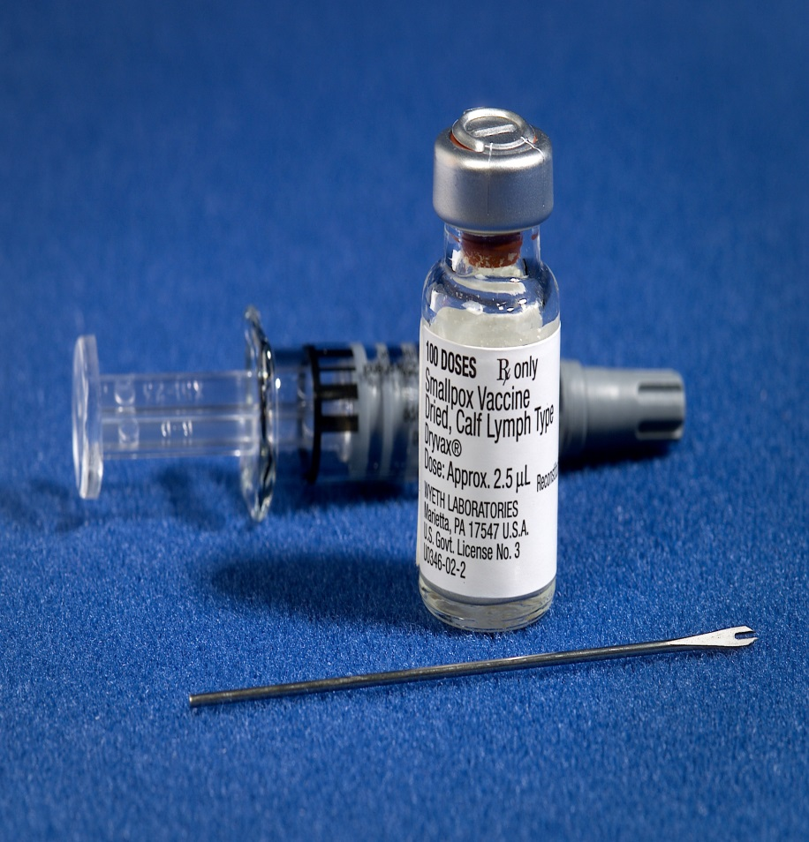
Small Pox vial found in Washington, DC July 2014
http://en.wikipedia.org/wiki/File:Smallpox_vaccine.jpg
Notes:
Serious issues could result if these vials of live viruses had been exposed to the public. News article: http://www.wtop.com/267/3658572/Forgotten-vials-of-smallpox-found-in-storage-room

Slide 9
Three types (stages) of Biomedical research:
Basic
Applied
Clinical

Slide 10
Basic Research
is conducted to increase the fundamental knowledge of the physical, chemical and functional mechanisms of life processes or disease
it is not directed toward solving any particular problem
It provides building blocks for other types of research

Slide 11
Applied Research:
is directed toward specific objectives. Involves the application of existing knowledge (obtained through basic research). Often involves animals and computer models
takes place in lab setting
Is conducted with animals, non-animal methods and computer models or tissue cultures.

Slide 12
Clinical Research:
Builds on what is done in basic and applied research applying it to the human clinical research (for treatment and prevention of diseases)
Is used to test drug and device treatment in humans
takes place in hospital or clinical setting

Slide 13
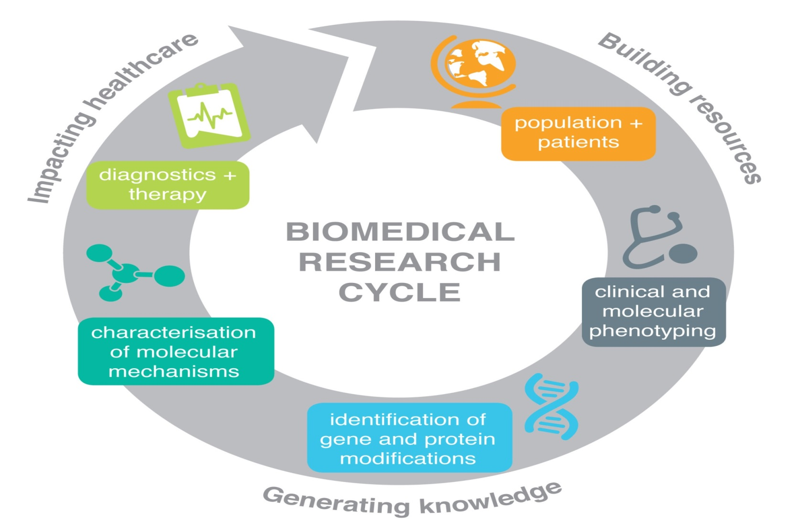
Pervasive reach of BMT:
http://www.eurac.edu/en/research/institutes/centerofbiomedicine/CBM/StrategicGoals.html

Slide 14
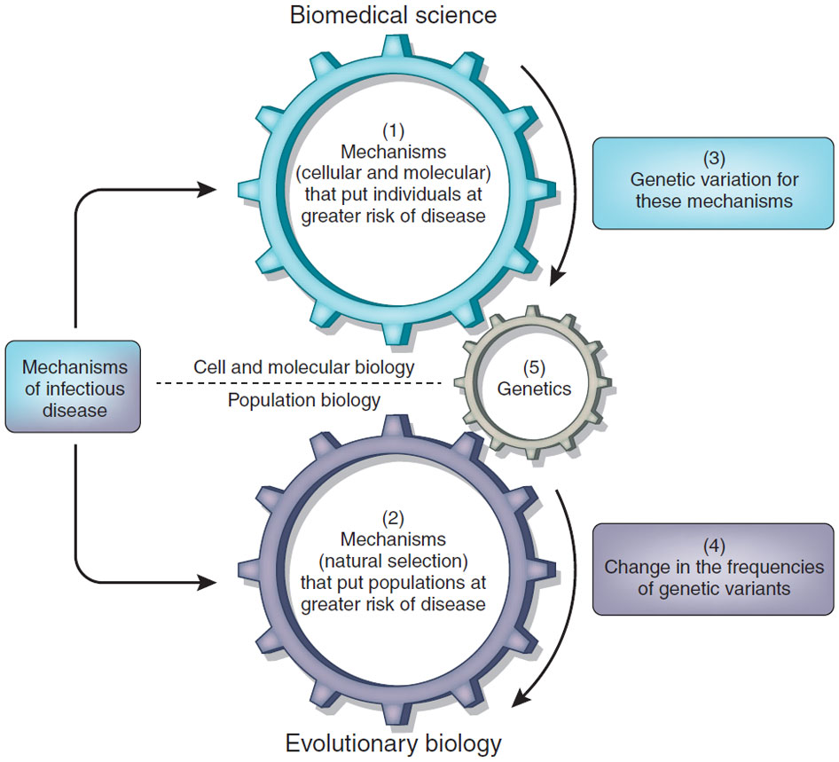
What biotechnical scientists do:
http://www.nature.com/nm/journal/v18/n2/fig_tab/nm.2572_F1.html

Slide 15
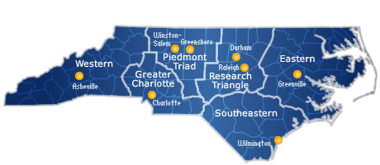
Where are the NC Biotech regions?
http://directory.ncbiotech.org/sites/all/themes/custom/ncbc_compdir/images/map/map-regions.png

Slide 16
Fast Facts: North Carolina is the 3rd leading state for biotechnology with 600-plus companies!
128 contract research and testing companies -- one of the world's greatest concentration;
80 agricultural biotechnology companies headquartered in North Carolina;
13 publicly traded companies with a market capitalization of $11.8 billion;
At least 75 based on North Carolina university technologies;
60,000 employees

Slide 17
More NC Fast Facts:
18 percent growth from 2001 to 2006, the fastest of the top 10 biotech states
Estimated $4.5 billion payroll
Average salary of $74,650 (2008)
$1.4 billion in state and local taxes
$176 million paid annually in personal state income taxes
About 145 bioscience patents granted each year to companies and universities

Slide 18
Biotech (BT) in NC
GlaxoSmithKline
BASF
Baxter Healthcare
Bayer
Biogen Idec
Labcorp
Merck
Novartis
Novo
Nordisk
Pfizer
Syngenta
Quintiles –
See more at: http://www.ncbiotech.org/about-us/press-room/fast-facts#sthash.raGDnMtb.dpuf

Slide 19
What is the origin of BM research?
Scientific discoveries by super scientists that led the way for us to build upon!

Slide 20
Super Scientists laid the foundation for BM researchers
Gregor Mendel
Charles Darwin
Watson and Crick
Louis Pastuer
Linus Pauling
Willhelm Rontgen
Alexander Flemming
Peyton Ross
Kary Mullins
Oswald T. Avery
Gertrude B. Elion & George Hitchings
J. Michael Bishop & Harold Varmus
Fredrick Banting & Charles Best
Sigmond Freud
William Harvey
Robert Koch
Anton Van Leeuwenhoek
Julius Axelrod
Karl Landsteiner
Barbara McClintock
Sir Peter Meawar
Stanley Cohen & Rita Levi-Montalcini
Peter Doherty & Rolf Zinkernagel
Georges Kohler & Cesar Milstein
Karl Landsteiner
Martin Rodbell
Rosalyn Yalow
Robert J. Lefkoitz
Karl Popper
Benjamin C. Preisner, III

Slide 21
Student Assignment (rubric): research your assigned scientist and create a 4-slide pp /prezi/ pictograph.
The student included his/her name, course / period on the first slide and the info was neat and organized | 25 pts
The student used appropriate grammar and spelling and included at least one source cited on the Power point | 25 pts
Who, what, when, where and how is clearly addressed regarding the scientist and his / her discovery. Add graphics/pictures. | 25 pts
The student will present his/her power point to the class and explain why he/she believes the discovery is important to the field of biomedical research | 25 pts

Slide 22
I cannot wait to see your work next week!!!
Be prepared to present on MONDAY!!

Slide 23
Let review: 1. What is science?
It is an unpredictable process.
It means Knowledge.
It is an inflexible, fixed discovery process.
It has little to do with BM research.

Slide 24
Answer:
b. Science is KNOWLEDGE!

Slide 25
2. The study of medicine:
devoted to life processes involved in the prevention and treatment of disease is ______________________________.

Slide 26
Answer:
BIOMEDICAL RESEARCH

Slide 27
3. An example of basic research is:
Clinical cardiac drug trial on humans at the hospital.
Cardiac drug study on animals performed in a lab setting.
Library research of earlier studies done on similar cardiac drugs.
Report on the news about drug shortages.

Slide 28
Answer:
Library research of similar studies

Slide 29
4. An example of applied research is:
Clinical cardiac drug trial on humans at the hospital.
Cardiac drug study on animals performed in a lab setting.
Library research of earlier studies done on similar cardiac drugs.
Report on the news about drug shortages.

Slide 30
Answer:
Cardiac drug study done on animals in lab setting

Slide 31
5. An example of clinical research is:
Clinical cardiac drug trial on humans at the hospital.
Cardiac drug study on animals performed in a lab setting.
Library research of earlier studies done on similar cardiac drugs.
Report on the news about drug shortages.

Slide 32
Answer:
Clinical drug trial on humans conducted in a hospital setting.

Slide 33
6. What is the third leading state for Biotechnology?
Pennsylvania
Washington State
Michigan
North Carolina

Slide 34
Answer
North Carolina with 600 + biotech companies

Slide 35
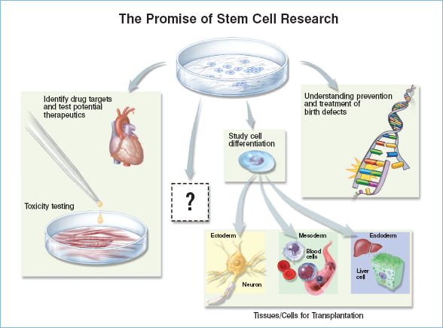
NEXT lessons(s) will cover: BM research methods & Benefits of BM research

