Slide 1
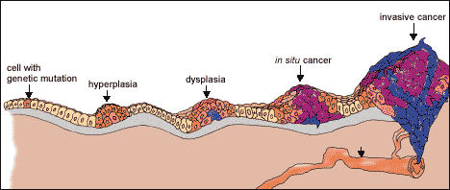
Cancer and Cell Biology

Slide 2
Cancer Facts
Group of 100 diseases that develop across time
Characterized by uncontrolled cell division
Can develop in virtually any of the body’s tissues
Hereditary and environmental factors contribute to cancer development
Second leading cause of death in U.S.
Men have one in two lifetime risk, women one in three

Slide 3
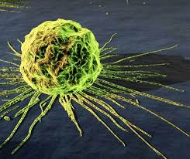
Types of Cancer
Benign-not harmful
Malignant-potentially deadly
Metastatic-spread to another part of the body
Type depends on cause and location
Each type has its own growth rate, prognosis, and treatability

Slide 4
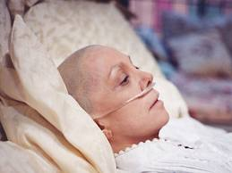
Cancer
Incidence increases with age
Inherited predisposition
Can inherit a cancer susceptible mutation
Occurs in all the body’s cells

Slide 5
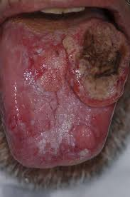
Risk Factors
Exposure to carcinogens
Cigarette smoking
Exposure to the sun
Females – family history of breast cancer
Fair skin
Chemicals, radiation, and viruses

Slide 6
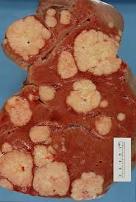
Cancer
Chance of surviving cancer increases with early detection and treatment
Incidence rate
Mortality rate
Survival rate

Slide 7
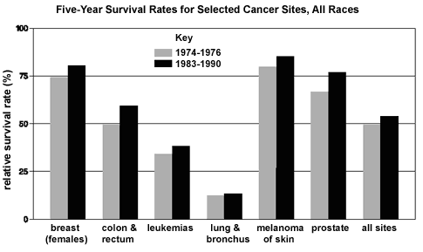
Survival rate

Slide 8
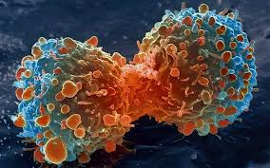
Causes and development of cancer
A. Many different agents can cause cancer
B. Cancer represents a breakdown of the processes that regulate the growth of normal cells and tissues
Cancer involves the uncontrolled division of body cells
Cell division is normally precisely regulated

Slide 9
Causes and development of cancer
Cell cycle regulation is accomplished by two major types of genes
Cancer-causing agents often damage genes
When damage occurs to genes that regulate the cell cycle, signals that inhibit cell division can change leading the cell to divide more often than it normally would

Slide 10
Causes and development of cancer
Cancer develops from genetic damage to cells across time
Cancer research leads to understanding normal cell cycle and new strategies for treating cancer
Stages of tumor development
1 Mutation
2. Hyperplasia
3. Dysplasia
4. In situ cancer (tumor)
5. Invasive cancer (malignant

Slide 11
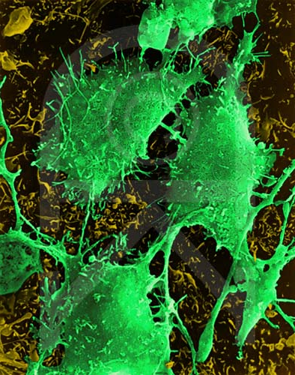
Genetic damage and mutation
Cancer results from the accumulation of genetic damage to cells across time
Cancer cells differ from normal cells
1. Shape changes
2. Changes in their dependence on growth factors
3. Multitude of biochemical differences

Slide 12
Genetic damage and mutation
Cancer is a multi-step process, which explains
1. Increased incidence of cancer with age
2. Development of cancer decades after exposure to carcinogens
3. Increased incidence of cancer among people with inherited dispositions

Slide 13
Improve personal and public health
Good choices can reduce an individual’s risk of developing cancer
1. Levels of cancer prevention
Individual behavior changes
Health care providers – counseling and screening
National level – government regulations to minimize public exposure to known carcinogens
International level – actions of developed countries bring cancer worldwide
2. Attention to ethical and public policy issues

Slide 14
Improve personal and public health
Risk factors for skin cancer
1. Excessive exposure to UV (ultraviolet) radiation
2. Fair complexion
3. Occupational exposure to substances
a. Coal tar
b. Creosate
c. Arsenic compounds
d. Radium
Good choices can improve an individual’s chance of survival if he/she develops cancer
1. Improved detection
2. Improved treatment

Slide 15
Improve personal and public health
Ethical values sometimes conflict in public policy debates about strategies for reducing the risk of cancer
1. Ethics is a process of rational inquiry
2. Ethics requires a solid foundation of information and careful interpretation of that information
3. There are often competing, well-reasoned answers to what is right and wrong, or good or bad

