Slide 1
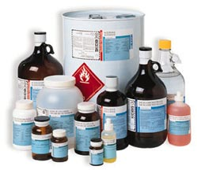
Careers in Biotechnology
Objective 4
Outline biotechnology careers and genetics

Slide 2
Biotechnologist
What is one the main jobs a biotechnologist
has?
Clones DNA and develops recombinant DNA
O.K. , what does that mean?
They are two developments that led to the
emergence of biotechnology as a medical /
science discipline.

Slide 3
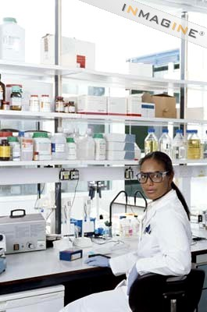
Biotechnologist
What type of work environment
do biotechnologist work in?
They typically work in laboratory
settings that have strict safety
and procedural guidelines
established by the National
of Health.

Slide 4
That’s nice but I still don’t know what cloning and recombinant DNA are?
Cloning in the field of biotechnology refers to processes
used to create copies of DNA fragments (molecular
cloning), cells (cell cloning), or organisms.
Recombinant DNA is a form of synthetic DNA that is
engineered through the combination or insertion of one or
more DNA strands, thereby combining DNA sequences
that would not normally occur together.

Slide 5
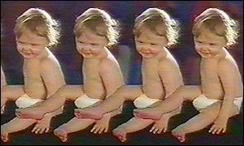
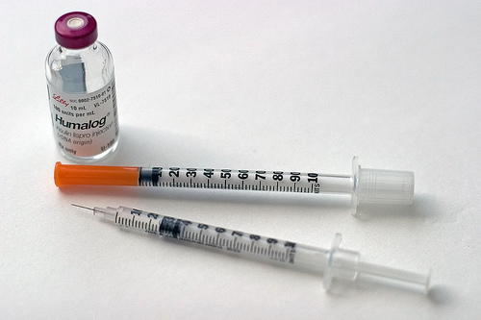
Uhhh…in English please.
Cloning = making an exact copy
Recombinant = making a
“remixed” copy

Slide 6
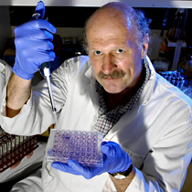
How “dangerous” can a lab be? Why do they need safety and procedural guidelines?
Since biotechnologists often work with
both pathogenic and non-pathogenic
microorganisms as well as chemicals it is
important for them to be protected from
potential illness or injury.
NIH guidelines for the
procedures involving
transfer and manipulation
of DNA are in place to assure
this technology is used as it should be.

Slide 7
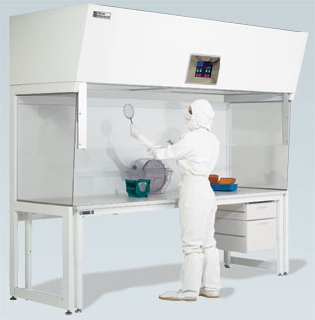
What are some of examples of safety guidelines used in the labs?
Laminar flow hoods to vent and filter air
Strict sterilization procedures to prevent cross-contamination, spread of pathogens or mutated genes, etc.
Careful planning to ensure all microorganisms are harmless

Slide 8
Random Facts About Biotechnology Careers
Most biotechnologists work
in private biotechnology
companies.
A biotechnologist is a type of
scientist that alters the cells
of living things to discover
and improve genetic traits.

Slide 9
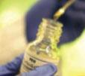
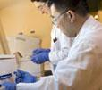
Biotechnology is rapidly making complex
advances.
There are over 1000 biotech companies in
U.S. most working in diagnostic and
therapeutics.

Slide 10
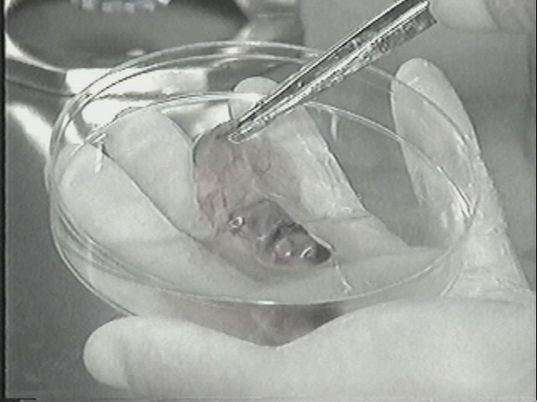
Biotechnologists are
also involved in non
DNA biotechnologies
such as preparing
tissue cultures, growing
stem cells, using
immunological methods
to detect pathogens
(in medical research),
and studying animal
and plant cells to
develop new
pharamceuticals.

Slide 11
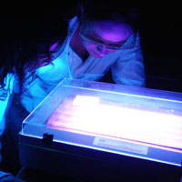
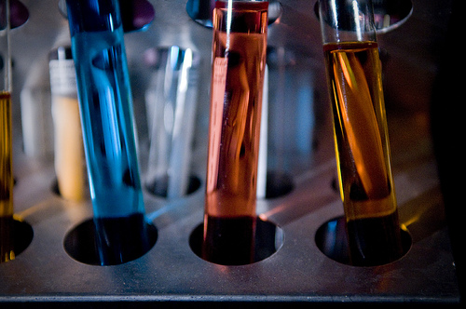
The biotechnologist in these other fields of study are typically called:
Medical biotechnologist
Research biotechnologist
Forensics specialist
Geneticist

Slide 12
Geneticists also known as “genetic counselors”
provide information and support to families who
have members with birth defects or genetic
disorders and to families who may be at risk for
a variety of inherited conditions.
Medical technologist work with the
production of antibodies for diagnosis or
treatment of disease.
Forensics specialist work to aid in solving crimes.

Slide 13
Remember this statement?
“NIH guidelines for the procedures involving transfer and
manipulation of DNA are in place to assure this technology
is used as it should be.”
Why do you think the NIH has to
regulate procedures involving DNA
so closely?

Slide 14
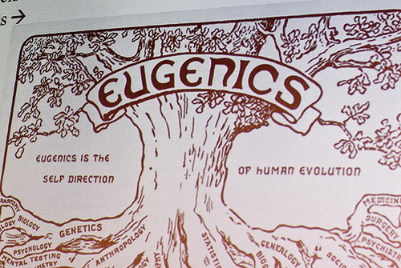
One answer is….
Ethical concerns related to eugenics.

Slide 15
What is eugenics?
Eugenics is a social philosphy which advocates the improvement of human heredity traits through various forms of intervention.
Examples are counseling a couple not to have a child because of a genetic issue and choosing the gender of the baby before implanatation during artificial insemination.

Slide 16
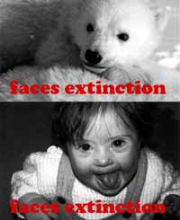
Explain the meaning of this picture.

Slide 17
End of Careers in Biotechnology
Objective 4
Outline biotechnology careers and genetics.
http://www.ncbiotech.org/biotechnology_in_nc/BiotechnologyVideo.html

